Slide 1

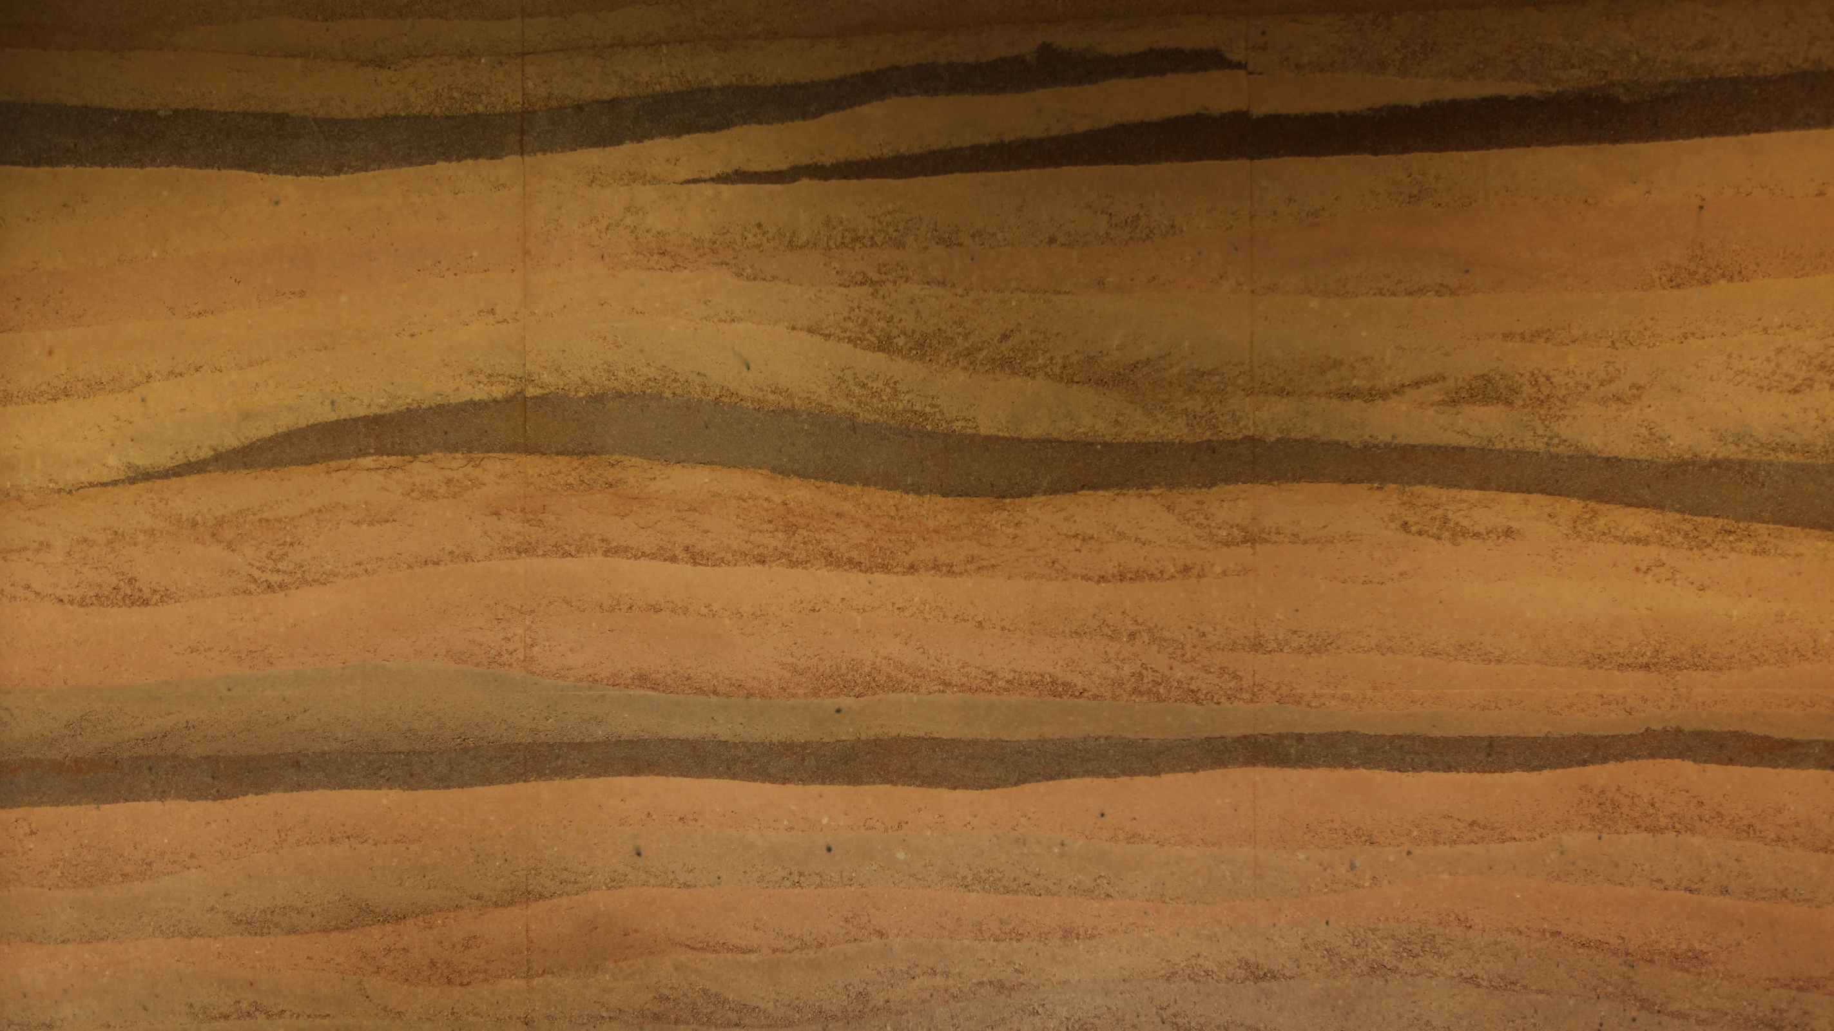
CHAD KRAUS
PROFESSOR OF ARCHITECTURE
A TERRA AD ASTRA
DIRT WORKS STUDIO AND THE NEW CLYDE TOMBAUGH OBSERVATORY
MUD HUT [2015]

Slide 2
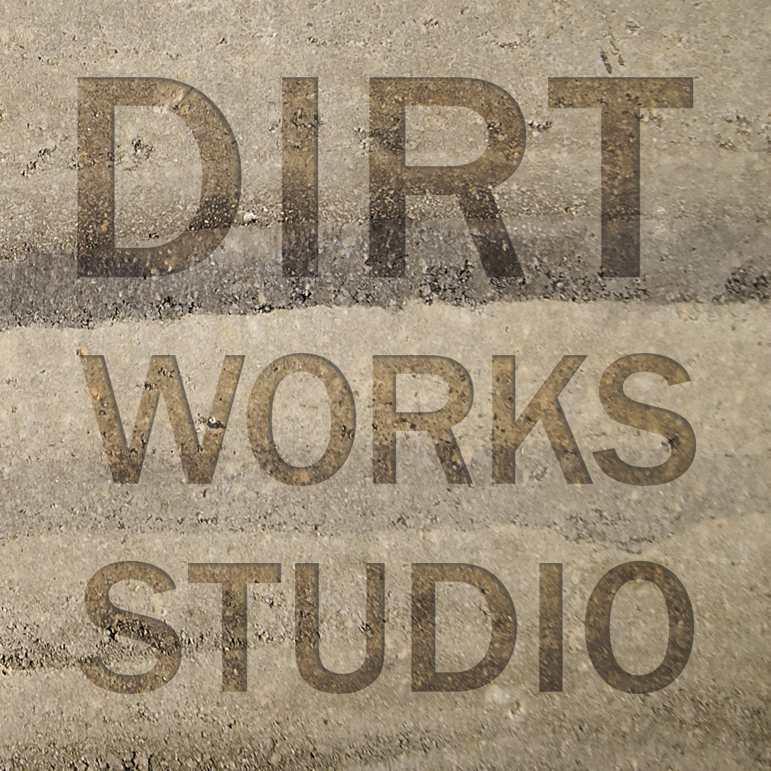

Slide 3
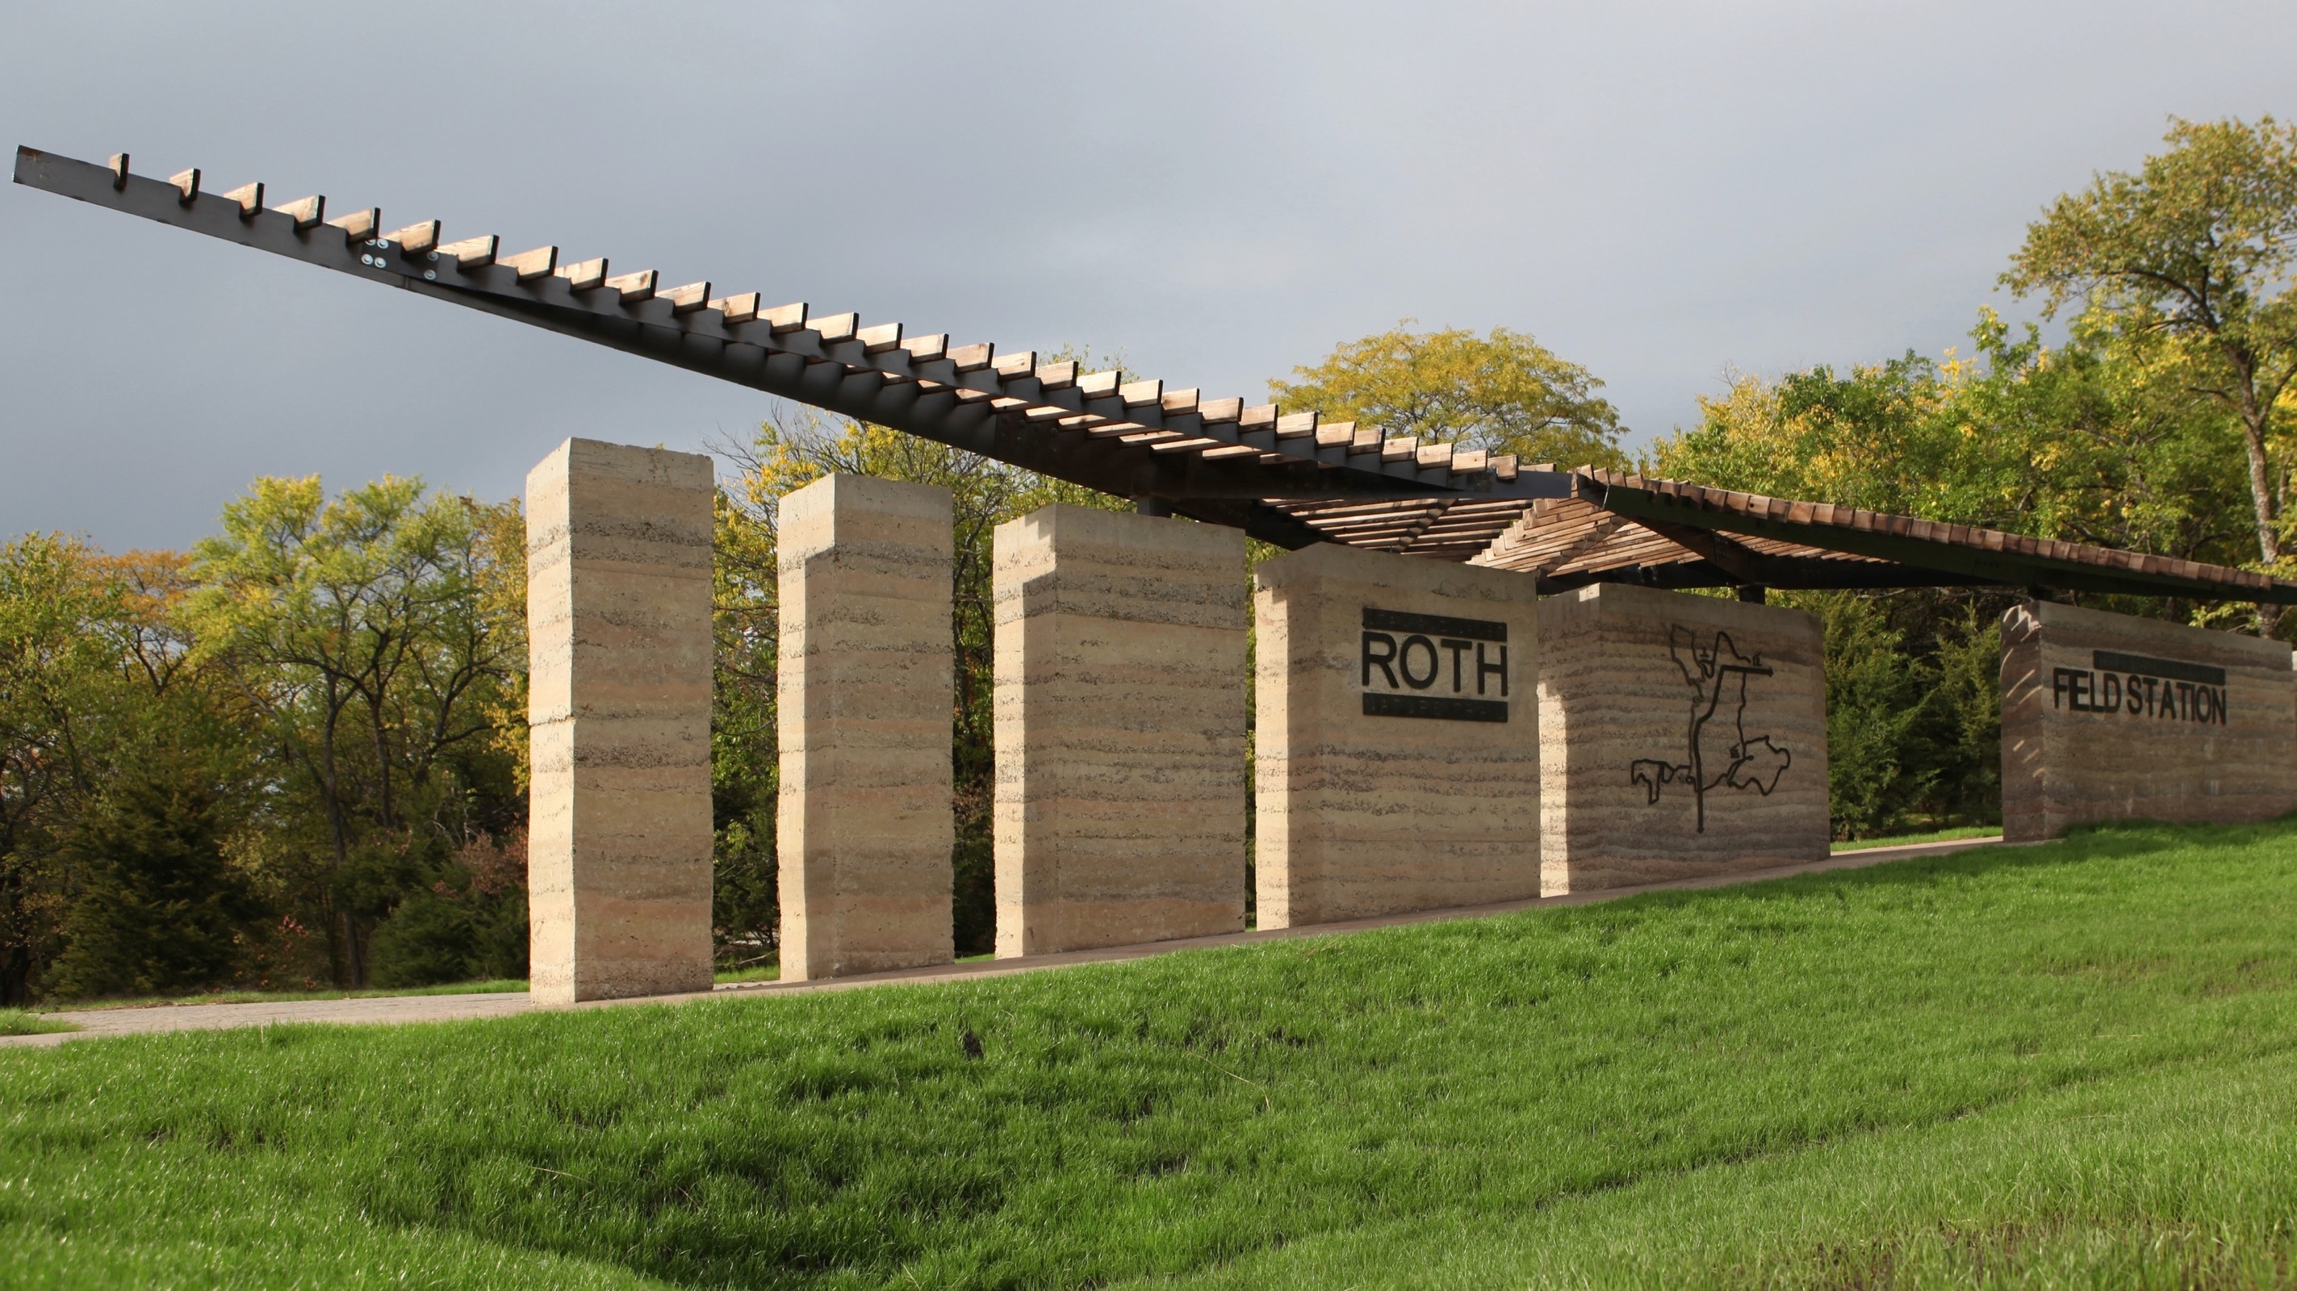
ROTH TRAILHEAD [2012]
Notes:
With simple materials and basic forms, the Studio sought to create a work of architecture that reflects the beauty of the given context.

Slide 4
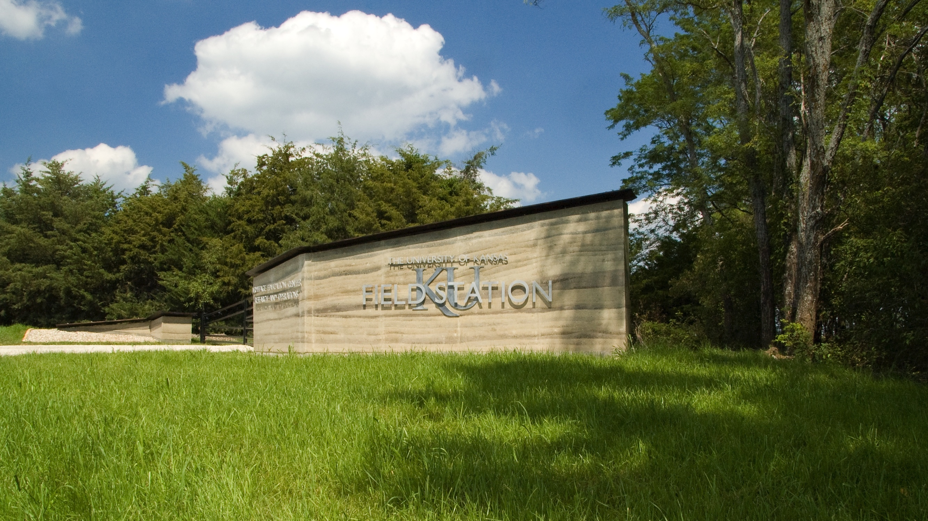
FIELD STATION GATEWAY [2013]
Notes:
The angle of the wall was positioned so that visitors to the Field Station would easily see it upon approach.

Slide 5
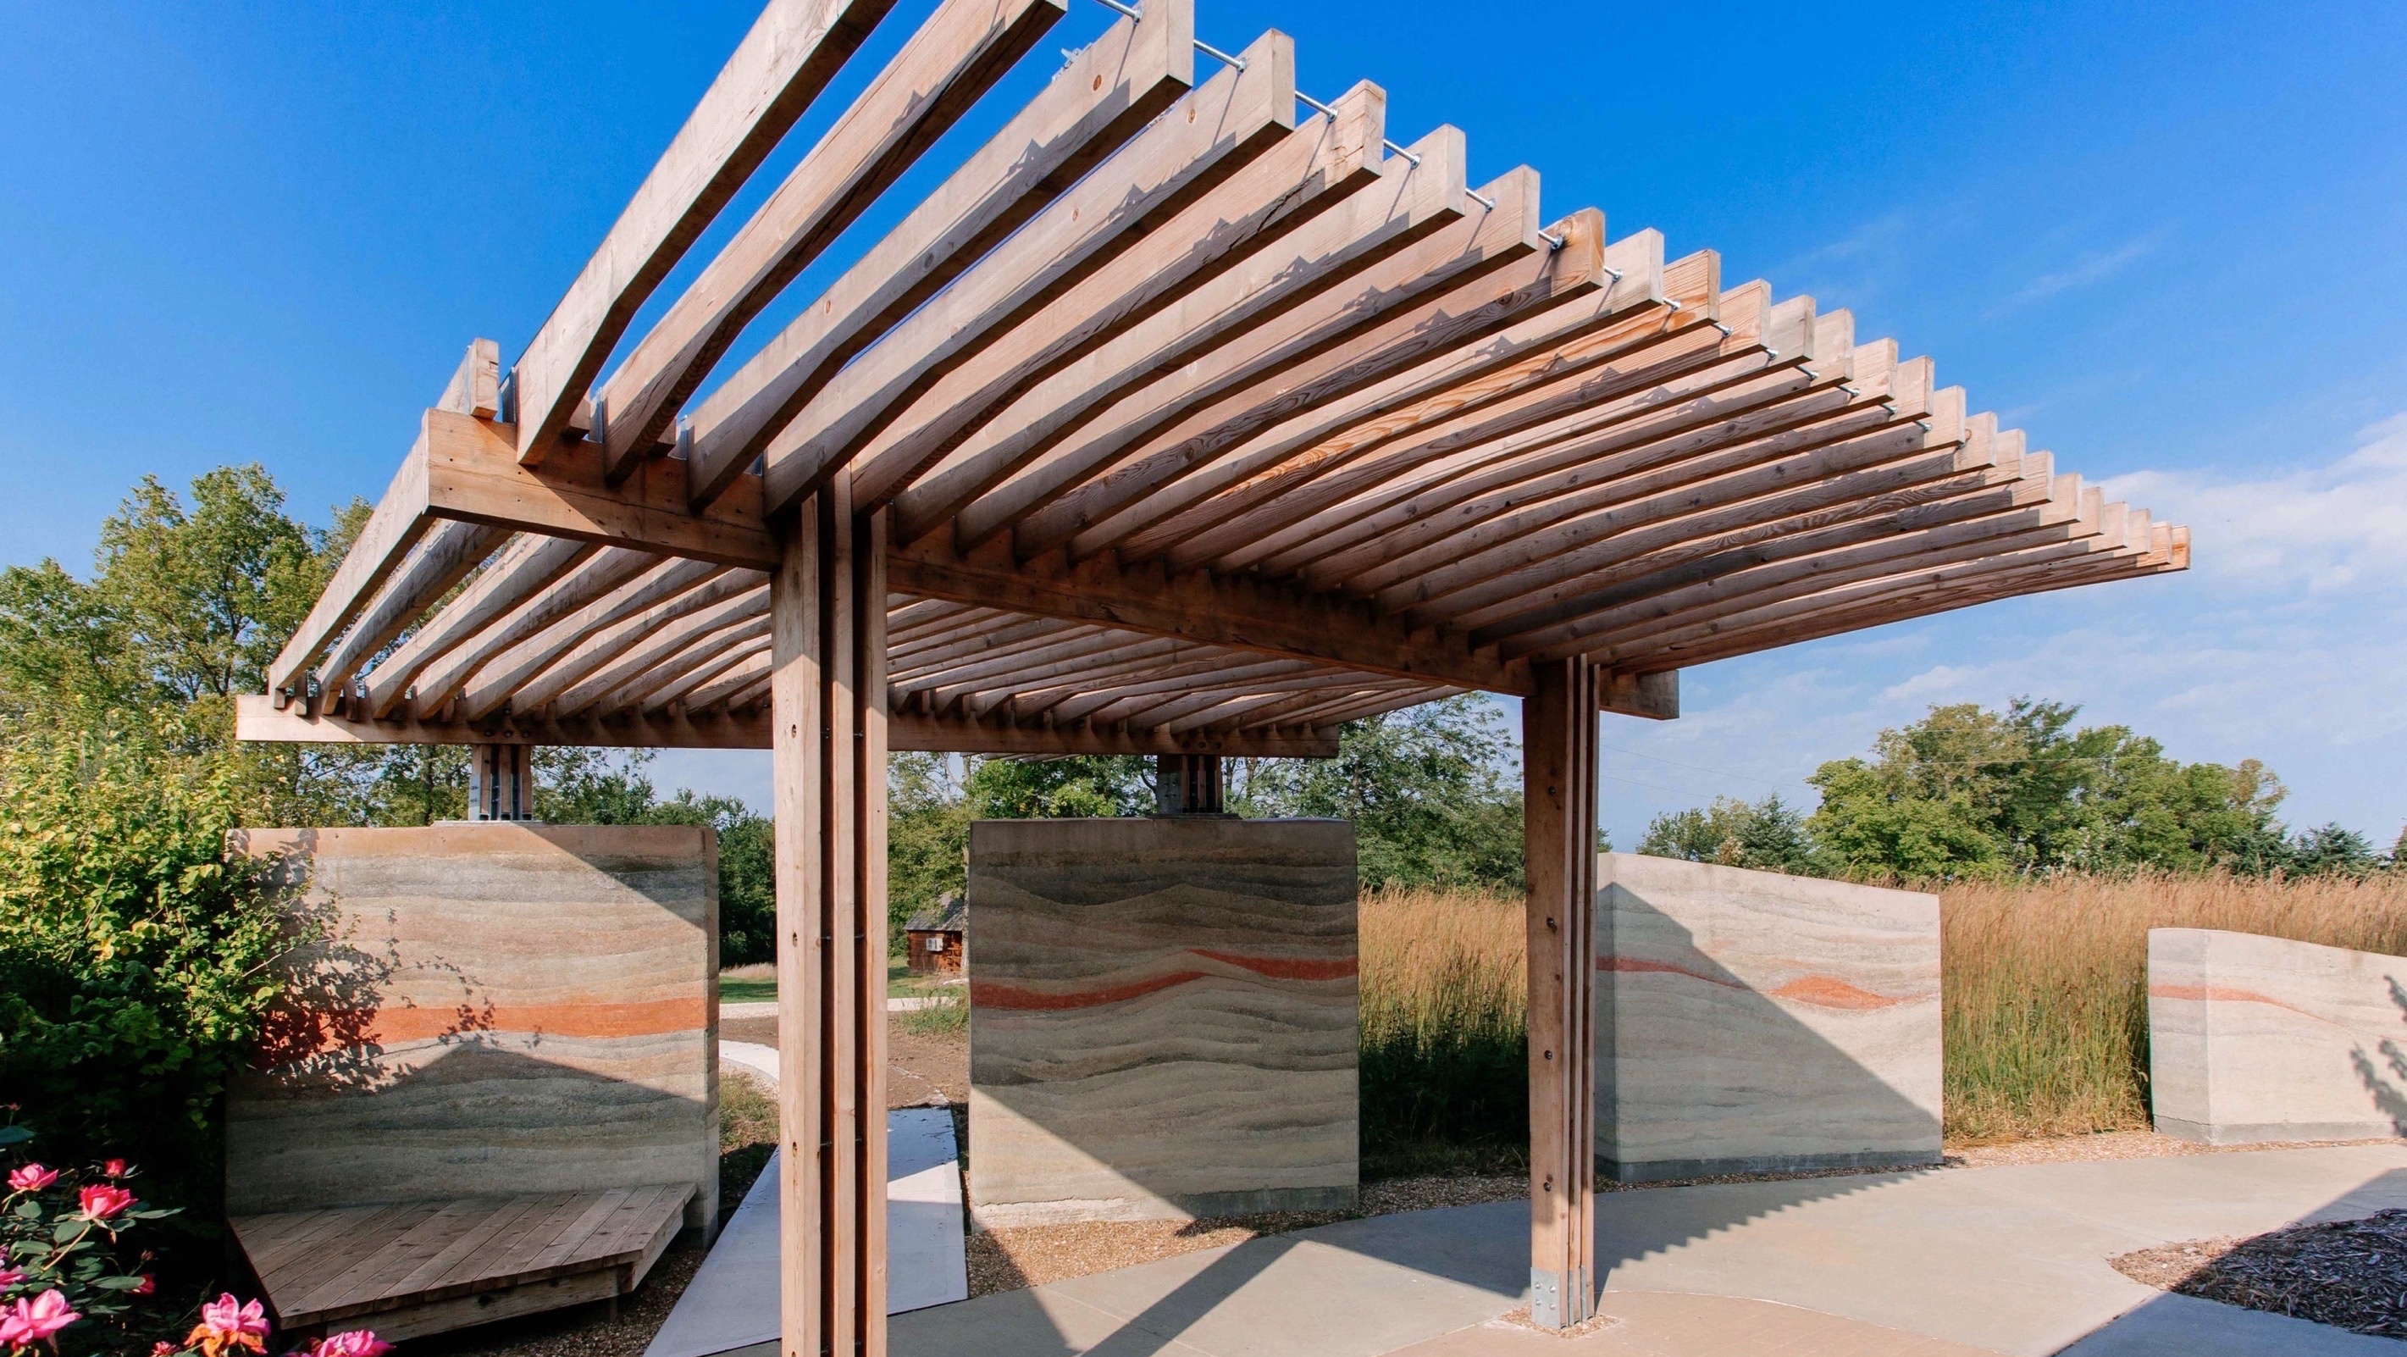
ARMITAGE PAVILION [2014]
Notes:
A novel double cantilever scheme was utilized to span the existing patio and provide ample shading. This part of the design evolved over the course of the construction. Originally intended to be made of long double cantilevering timbers, the roof had to be redesigned based on the limitations of budget and donated, reclaimed telephone pole timbers, which were simply not long enough.

Slide 6

SENSORY PAVILION [2016]
Notes:
As one enters the pavilion - the gravel crunching underfoot - the smell of the charred wood mixes with the sweet smell of the roses nearby. The temperature and texture of the earthen elements contrast with the wooden ones.

Slide 7

CHALMERS CAFÉ [2017]
Notes:
The wall separating the retail shop/classroom from the café was removed and, in its place, a sixty-foot long cross-laminated timber (CLT) wall now provides warmth and tactility.

Slide 8
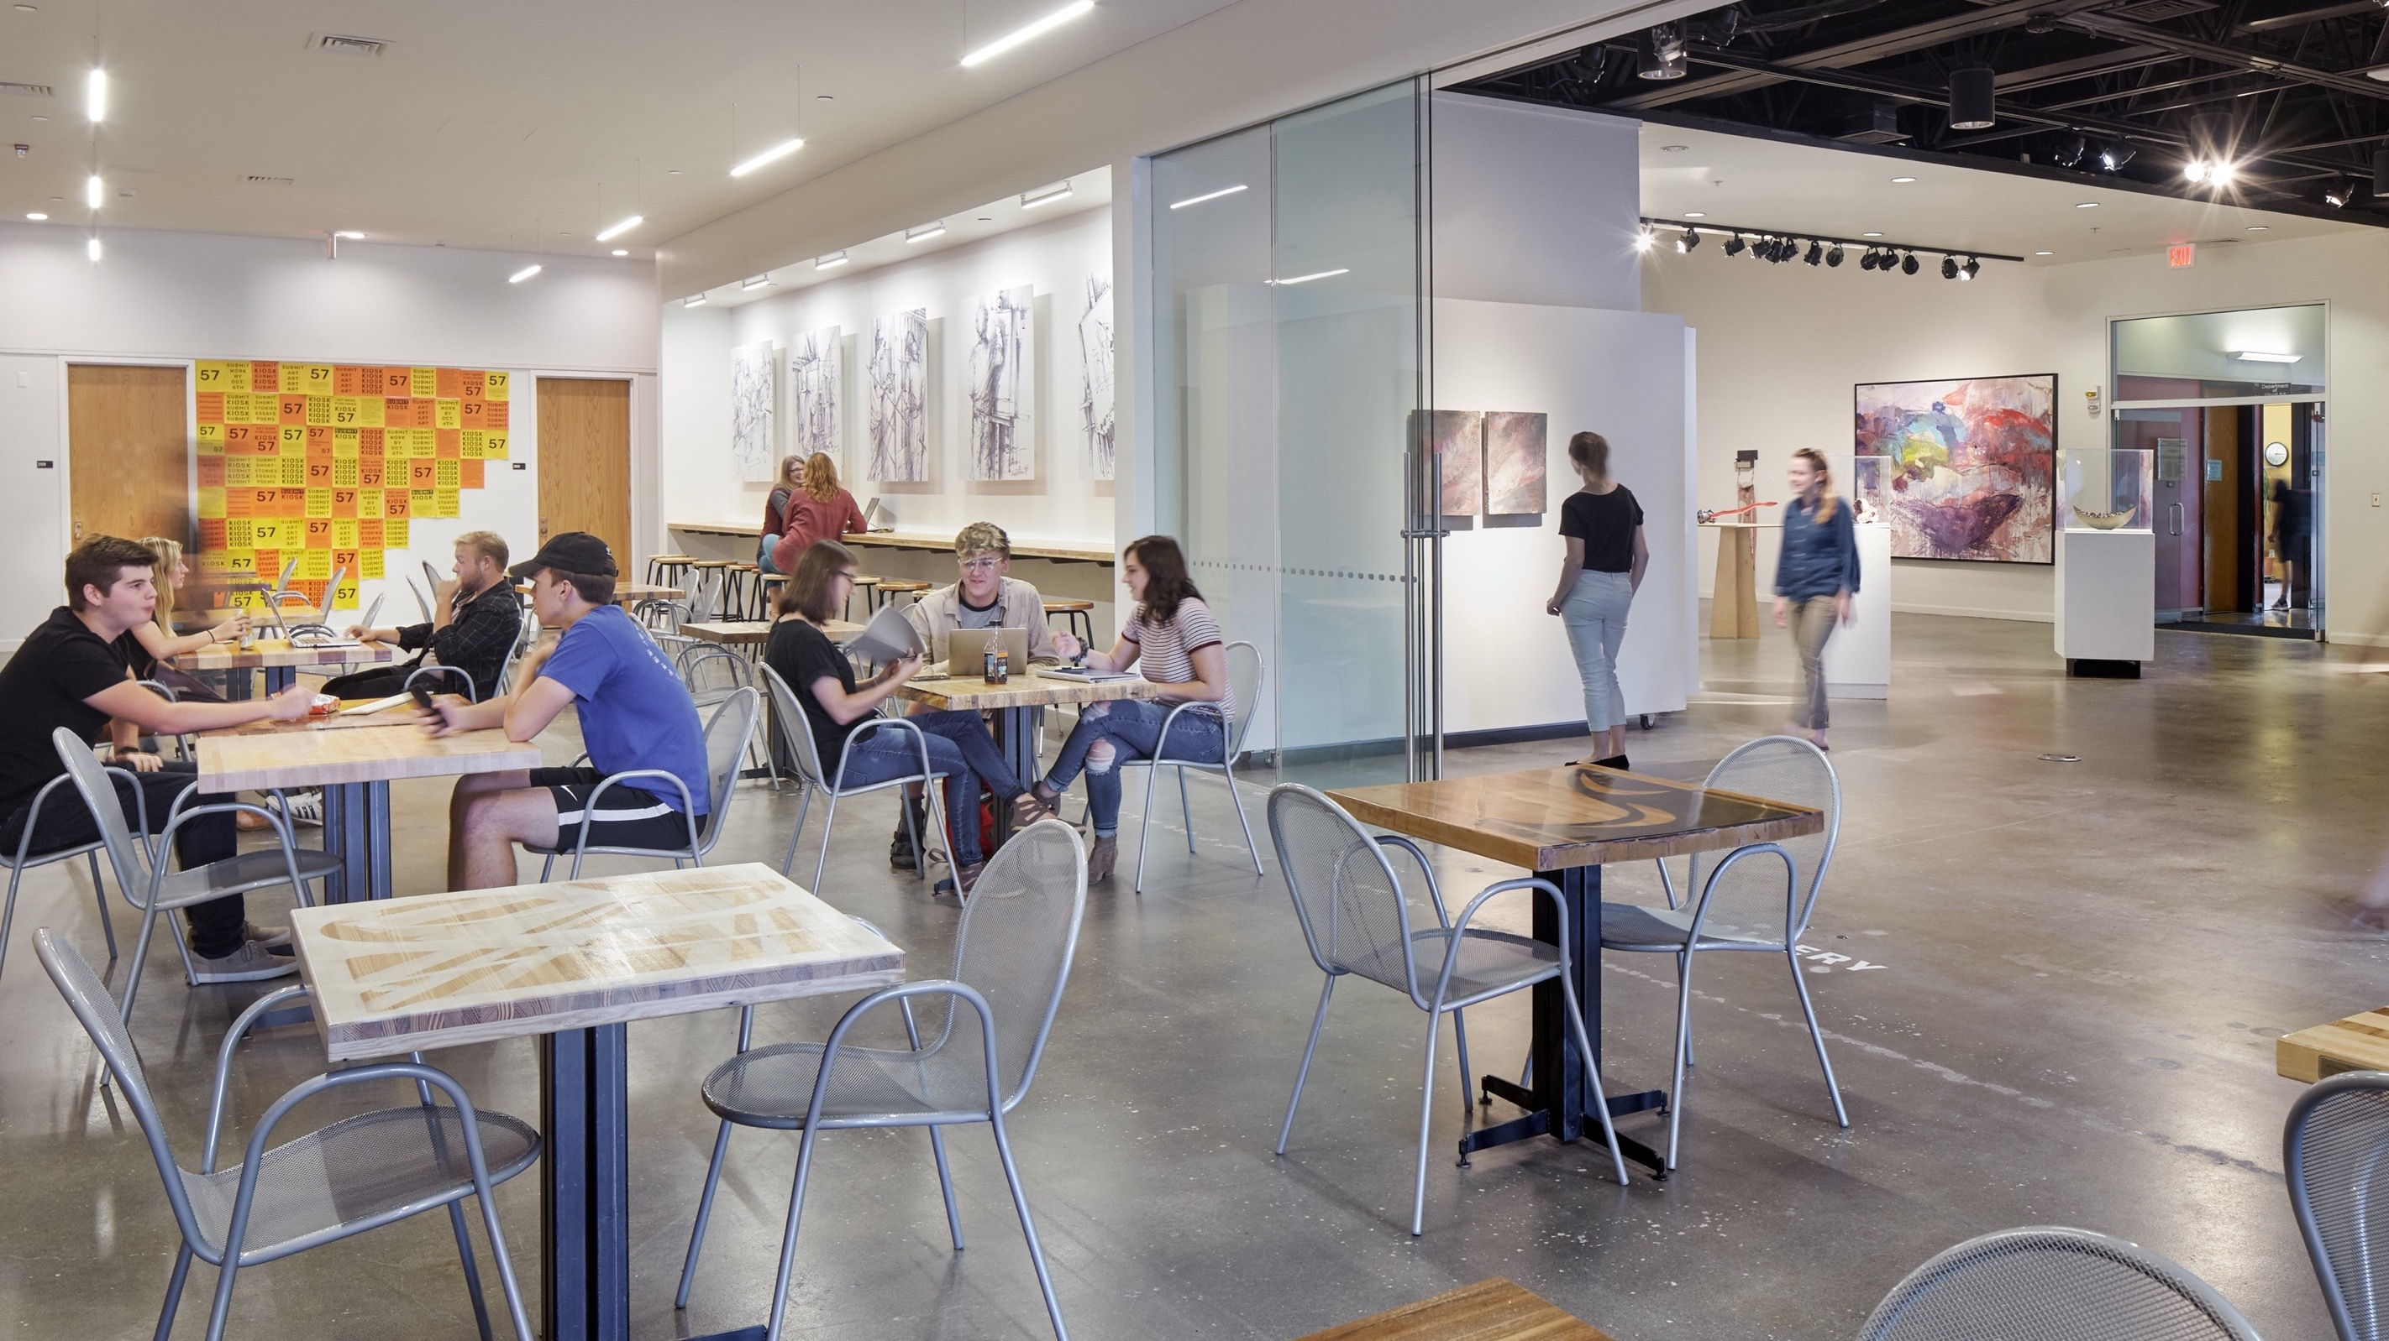
CHALMERS CAFÉ [2017]
Notes:
This adaptability is echoed by the café's integration with the art gallery via an operable telescoping sliding glass wall, alleviating the gallery's former lack of visibility and interaction. The contents of the gallery are now on full display; movement from one space to the other is fluid.

Slide 9

MAKERSTUDIO [2018]
Notes:
In the "up" position, sight lines and access to natural light and views across the studio are uninterrupted and the Hackberry work surface is available for use.

Slide 10
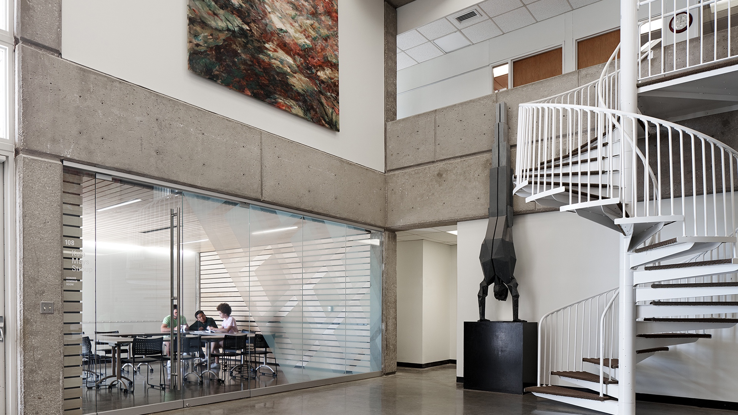
NUNEMAKER CLASSROOMS [2019]
Notes:
The result is two classrooms that are naturally lit, acoustically-calibrated, easy to find, technologically-upgraded, warm and inviting, and…

Slide 11
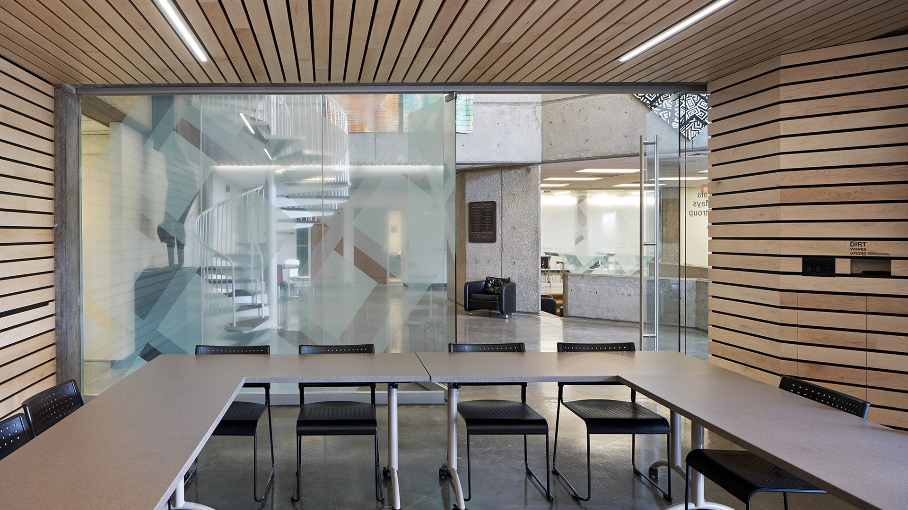
NUNEMAKER CLASSROOMS [2019]
Notes:
The maple slats wrap down the west and east end walls of each classroom, one of which was designated as an AV wall with flat screen televisions and concealed media closets.

Slide 12

PASSERINE PAVILION [2020]
Notes:
Along two sides of the deck, facing north and east, guardrails will transition into a series of wayside panels that will interpret the region’s geography and history. The arrangement will afford all visitors, regardless of their mobility, an experience of beholding the Wakarusa River Valley.

Slide 13

PASSERINE PAVILION [2020]

Slide 14
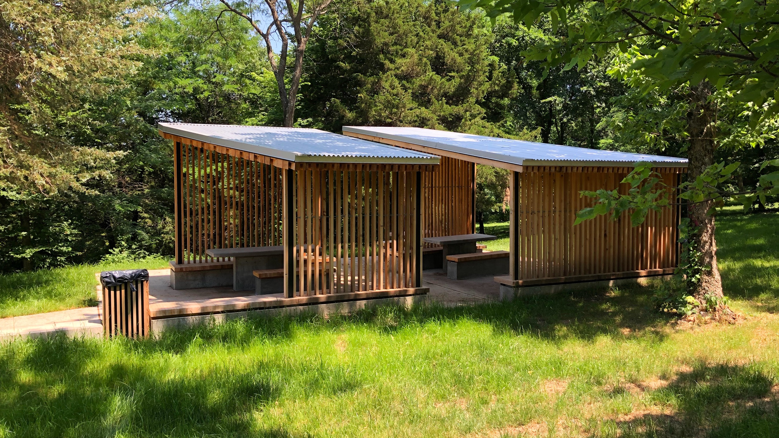
POLARIS PAVILION [2021]

Slide 15

POLARIS PAVILION [2021]

Slide 16
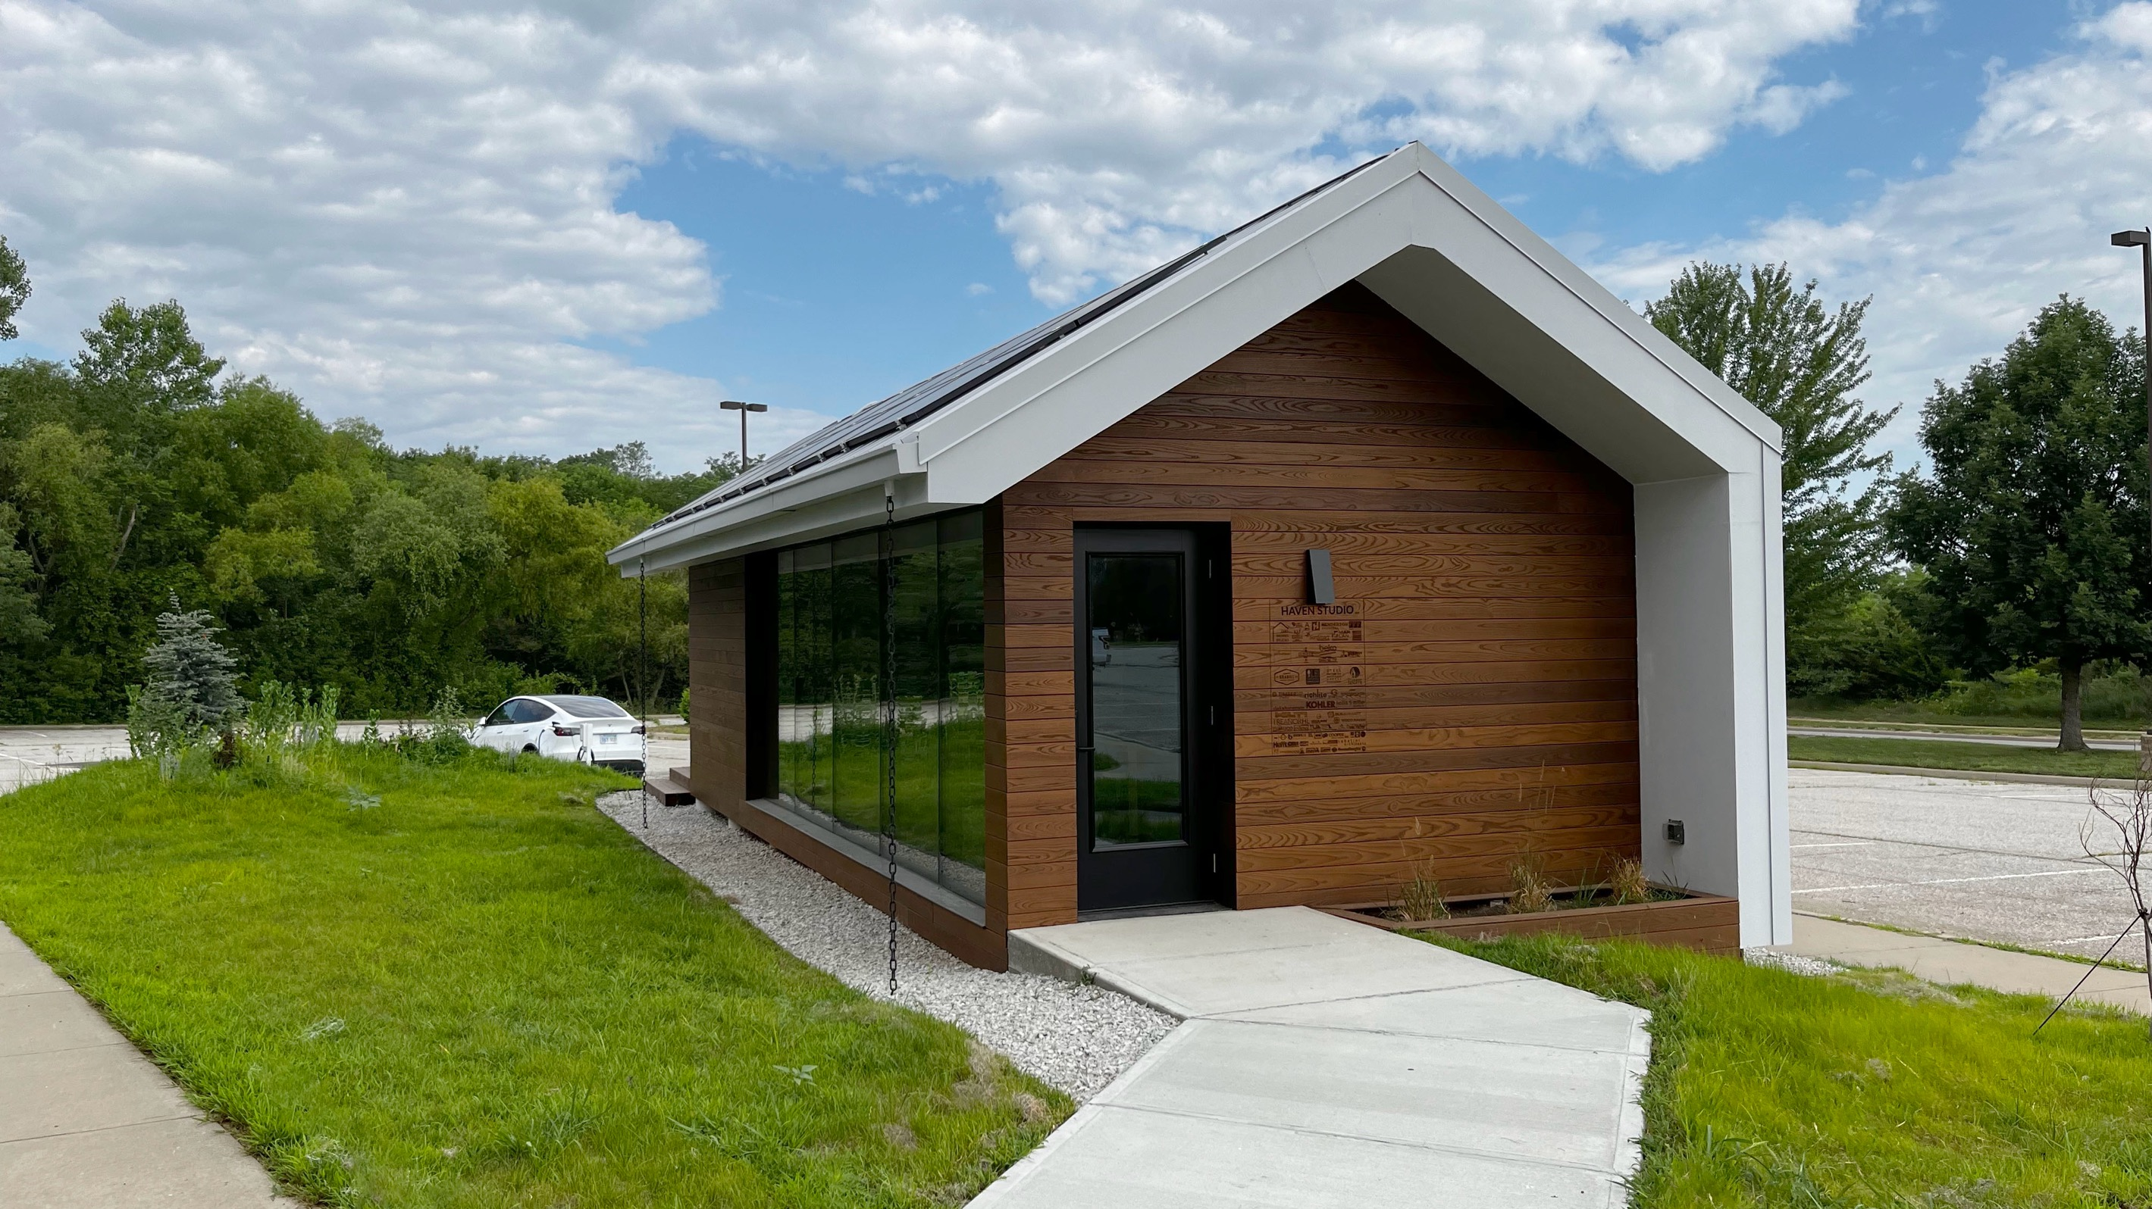
HAVEN STUDIO [2023]

Slide 17

HAVEN STUDIO [2023]

Slide 18
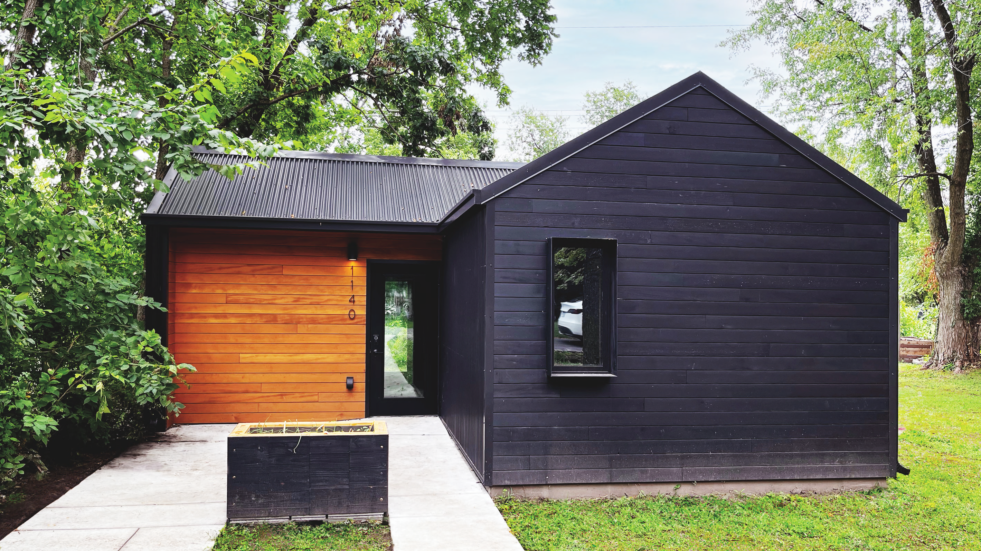
PHOENIX HOUSE[2024]
Notes:
Next week the studio will be breaking ground on the second project at Wells Overlook Park. The Polaris Pavilion will be a universally-accessible picnic structure nestled into a wooded area of the park. At the conjunction of two main grids, the Polaris Pavilion will rest at the northern half of Wells Ridge Forest. Wells Ridge Trail will bisect the two pods while still integrating them to the rest of the park. Two screw laminated mass timber roofs will span over wooden screens and cantilever to the east as the hill flows down into the wooded grove.

Slide 19

PHOENIX HOUSE[2024]
Notes:
Next week the studio will be breaking ground on the second project at Wells Overlook Park. The Polaris Pavilion will be a universally-accessible picnic structure nestled into a wooded area of the park. At the conjunction of two main grids, the Polaris Pavilion will rest at the northern half of Wells Ridge Forest. Wells Ridge Trail will bisect the two pods while still integrating them to the rest of the park. Two screw laminated mass timber roofs will span over wooden screens and cantilever to the east as the hill flows down into the wooded grove.

Slide 20
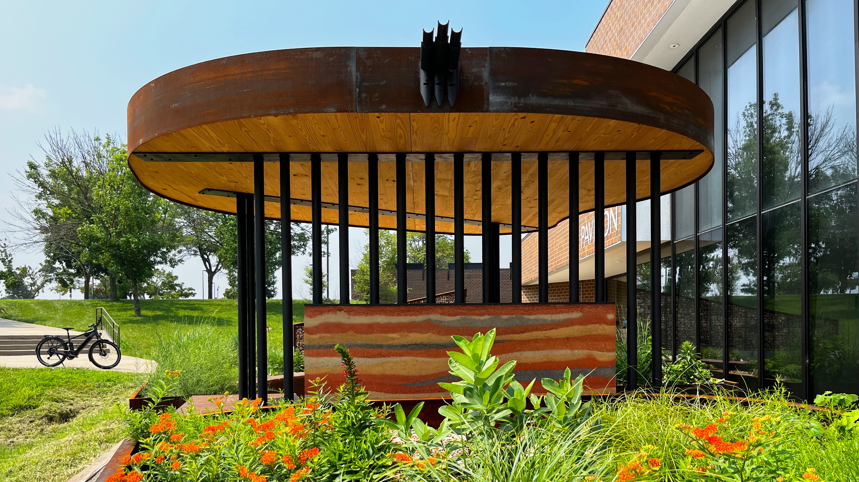
MANGO GARDEN [2025]

Slide 21
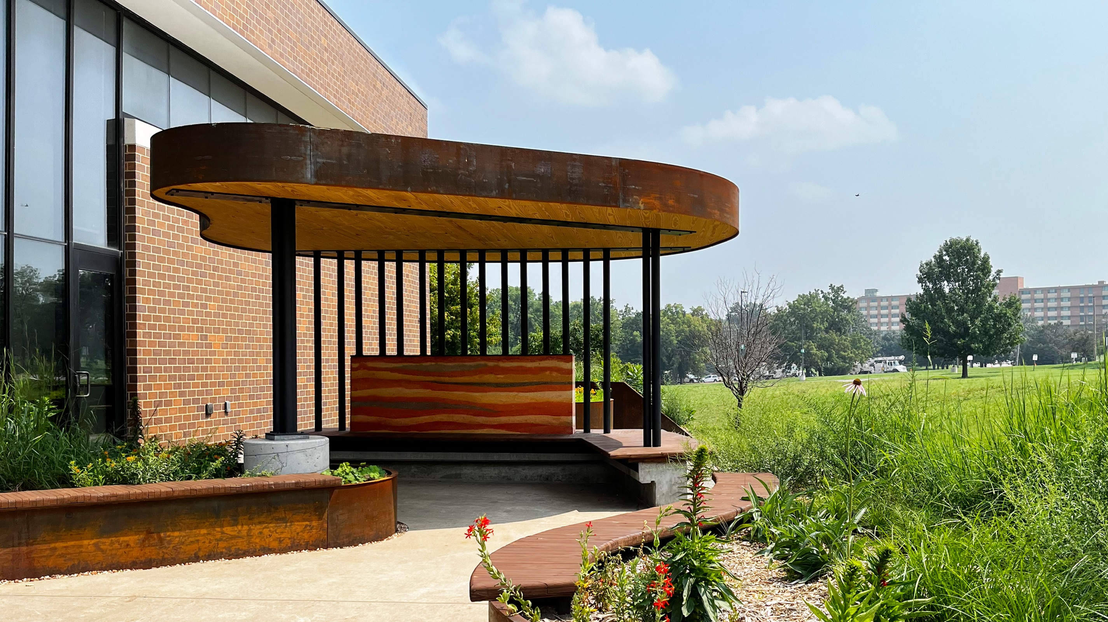
MANGO GARDEN [2025]

Slide 22
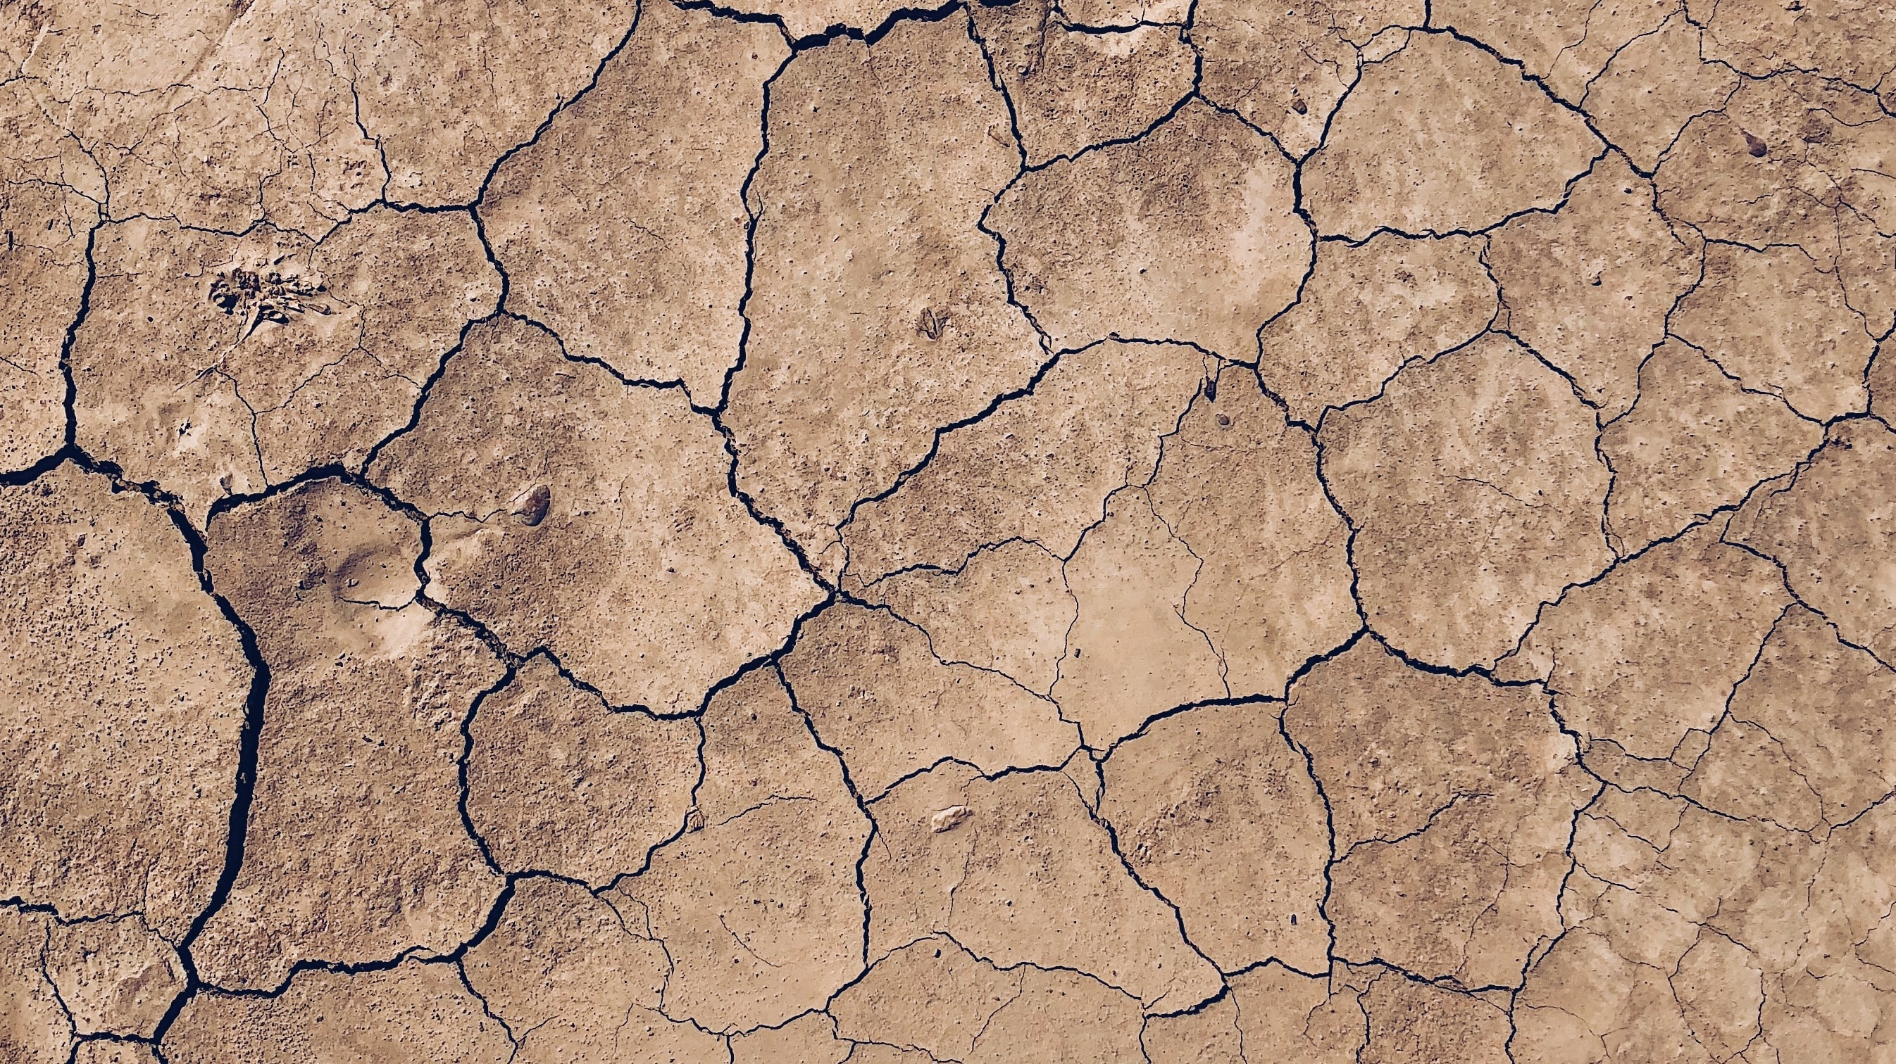
EARTH
Notes:
Let’s begin with Earth.

Slide 23
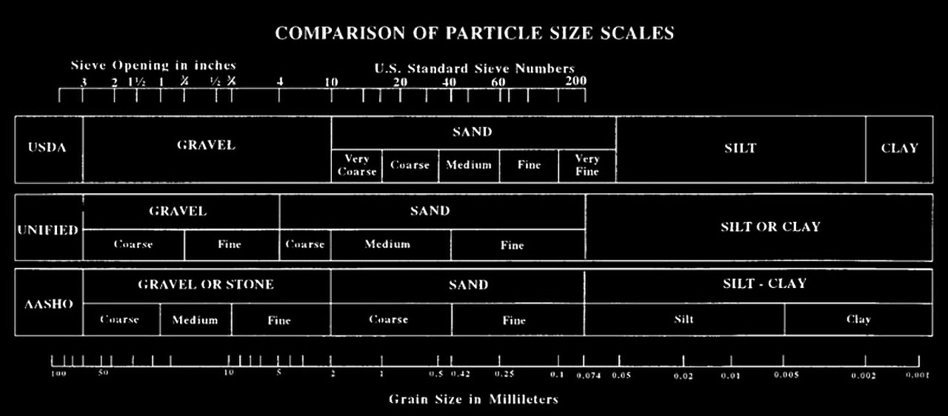
SOIL PARTICLE CLASSIFICATION
Notes:
Soil particles are characterized by their size, from coarse to fine, and are generally divided into gravel, sand, silt, and clay, as depicted in this chart.

Slide 24
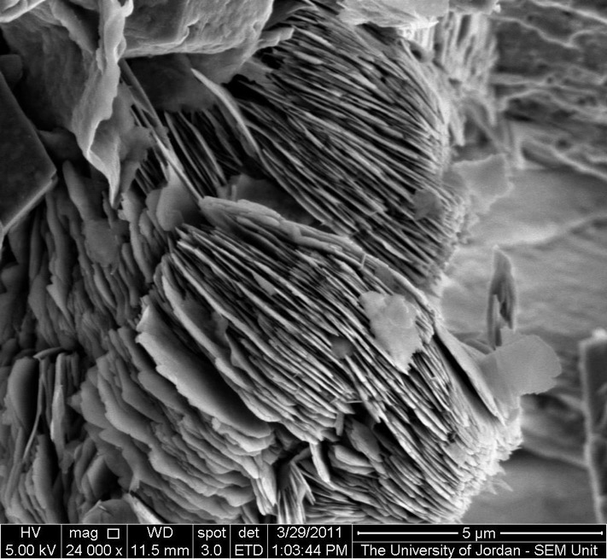
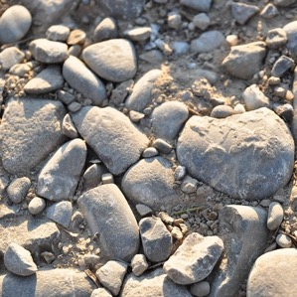
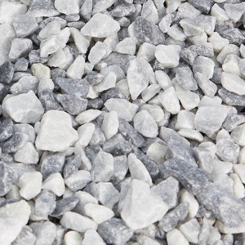
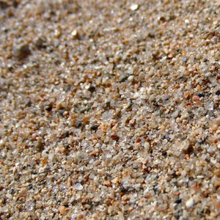
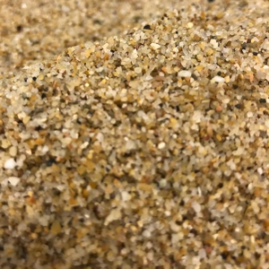
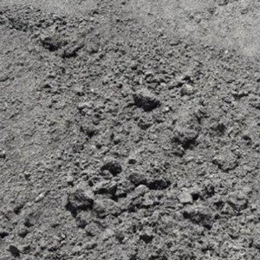
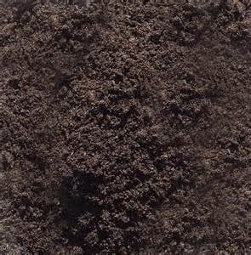
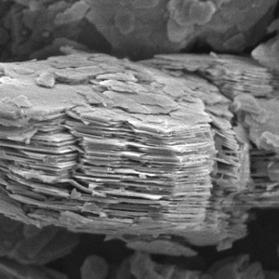
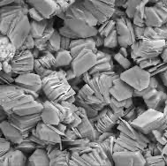
SOIL PARTICLE CLASSIFICATION
12 mm [.5”] grain; enlarged x10
1 mm [.041”] grain; enlarged x10
.033 mm [.001325”] grain; enlarged x10
GRAVEL
64 mm - 2 mm
[2.5” - .079”]
SAND
2 mm - 62.5 µm
[.079” - .0025”]
SILT
62.5 µm - 3.90625 µm
[.0025” - .00015”]
CLAY
< 3.90625 µm
[< .00015”]
Notes:
Let’s first start with gravel, which can describe particles ranging from 2.5” to a little larger than 1/16” in diameter. Here I have depicted an average-sized gravel particle, enlarged by 10 times. We all have a pretty good idea of what gravel looks and feels like, though, since you have likely experienced walking or driving along a gravel road, for example. Next, we have sands, which range from approximately 1/16” in diameter to 25 one-thousandths of an inch, in other words, pretty small…smaller than you can see with your naked eye. Again, here, for the sake of comparison, I am showing an average grain of sand, enlarged by 10. Now, to be clear, between this grain of gravel and this grain of sand, there are particles of every size increment, with the finest gravel being a merest fraction of an inch larger than the coarsest sand. Next, we come to the silts, which range from .0025” to .00015”. These particles are so small we can no longer refer to them by convenient units in the U.S customary system; even millimeters are much too large. Instead, we typically refer to these in microns. Silt grains cannot be distinguished to the naked eye, but when amassed, they form a soft, silky-smooth textured earth. Again, for the sake of comparison, I have enlarged an average sized grain of silt by 10, which you may or not be able to see on your screen. Finally, we come to the most fascinating classification of soil particles, the clays, which clock in at a mere four microns or smaller. What makes these particles so amazing though, is not their size, but rather their shape. Unlike gravel, sand, and silt, clay is not granular but rather consists of plate-like sheets with tetrahedral and octahedral morphologies, as seen here. These unique physical characteristics imbue clay with the ability to transform from malleable when wetted to a strong binder when dried, recovering its cohesive properties. Clay is the glue that holds soils together.

Slide 25
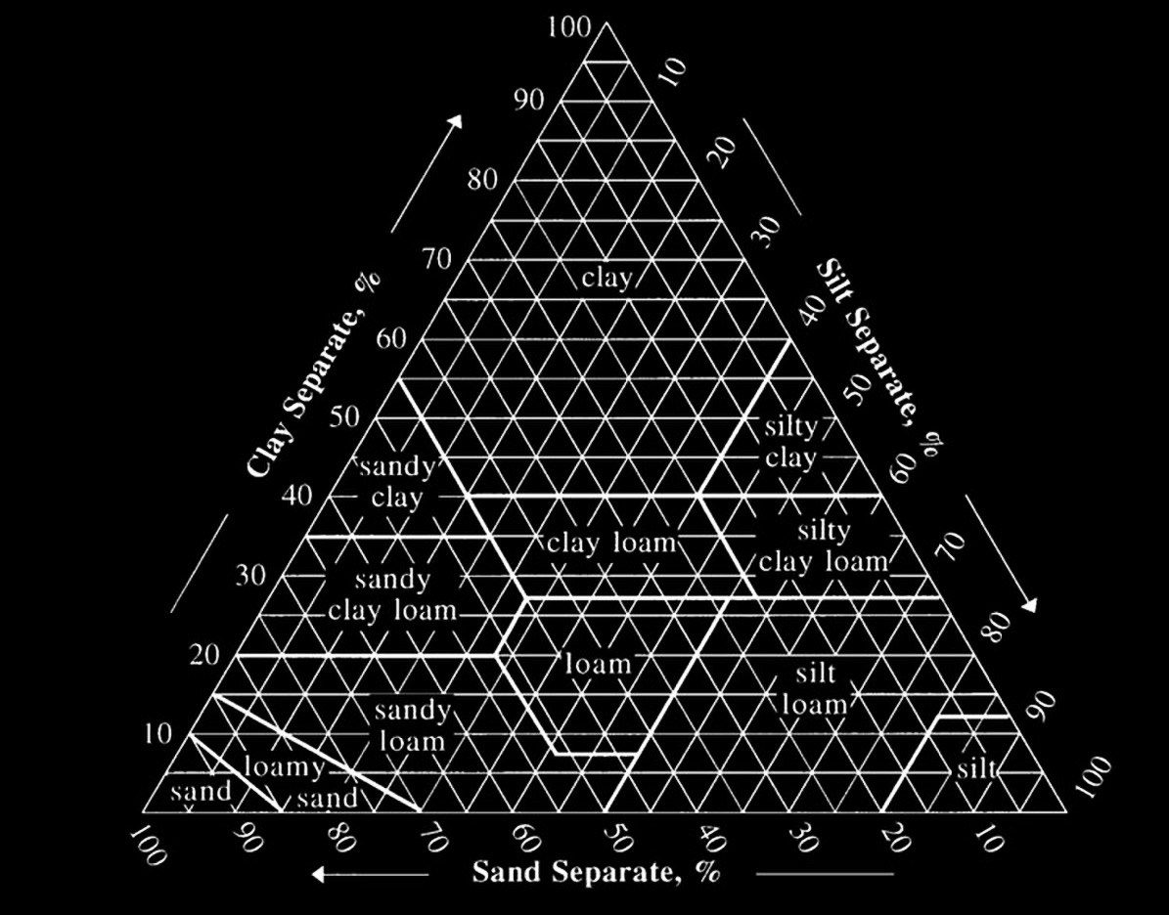
SOIL TYPE CLASSIFICATION
Notes:
Any soil will consist of a wide variety of particle sizes, often spanning across the full spectrum of gravels to clays. However, the proportion of each particle size will determine the overall character of the soil, and here we typically use a classification system such as this one, to name the soil types, such as a Sandy Clay Loam, or a Silty Clay.

Slide 26
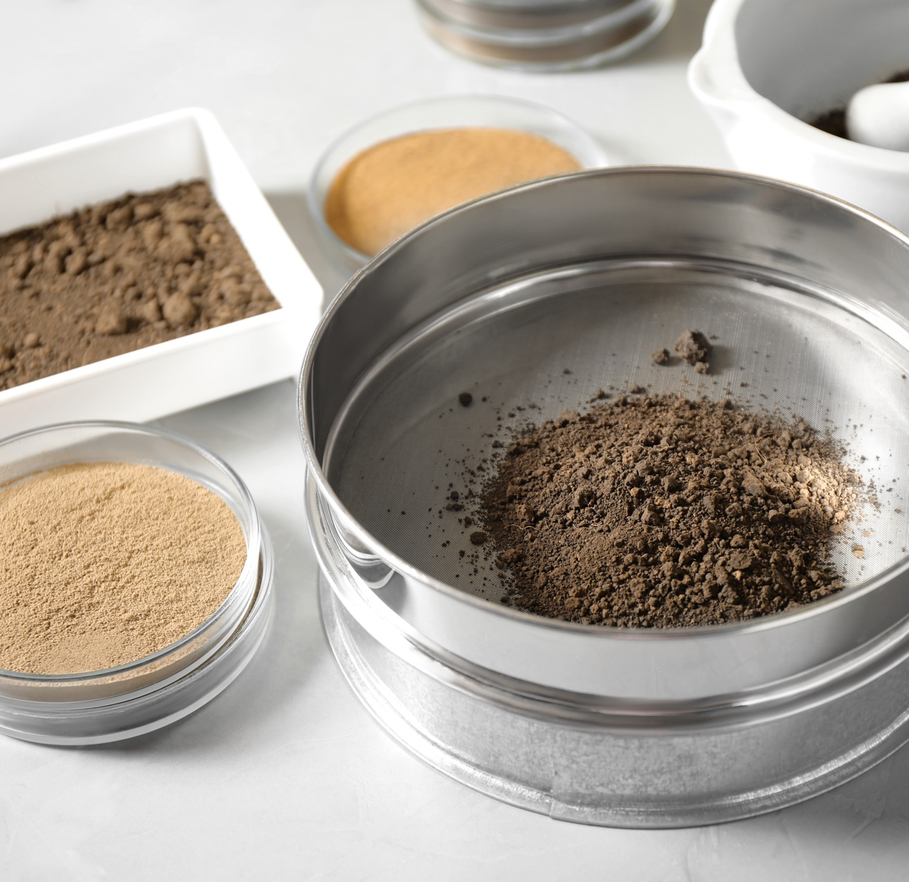

SOIL TESTING: PARTICLE SIZE DISTRIBUTION
Laboratory equipment for pulverizing and sieving of soil samples [left] (Photo credit: New Africa) and nested sieve analysis using a Ro-Tap machine [right] (Photo credit: Warut)
Notes:
Today, I am talking about earthen architecture, that is, earth used as a building material. In order to know if a soil is suitable to build with, one must conduct a series of tests, particularly since soil varies from place to place. The most basic test is to determine the particle size distribution, that is, how much gravel, sand, silt, or clay is in the soil.

Slide 27
SOIL TESTING: PARTICLE SIZE DISTRIBUTION
Ideal Characteristics for Earthen Building
- Non uniform particle sizes
- Well-graded soil (i.e. containing particles of a wide range of sizes, evenly distributed from the No.4 sieve to the No.200 sieve
- Ideal ratio of gravel, sand, silt, and, specially, clay
Soil particle-size distribution showing the percent by mass of each size fraction (bars; left axis) as well as the cumulative density function (dashed line; right axis).
Notes:
For earthen building materials,
you typically want a soil with a non-uniform particle size distribution,
and well graded, that is, containing particles of a wide range of sizes, evenly distributed.
We can illustrate this using a graph, such as this one. Allow me to illustrate why a non-uniform, well-graded soil is ideal. Our goal, when using earth as a building material, is to make it strong through densification and binding of the particles.
Imagine having particles of all one size, no matter how much you compact or vibrate the soil, you will always have void spaces between them of a relatively significant size.
Now imagine you added a smaller particle size to the mix and were able to completely densify the material, you can see here that we have far fewer voids relative to the mass of soil.
Yet again, if we add an even small particle size, we increase density, and so on.

Slide 28
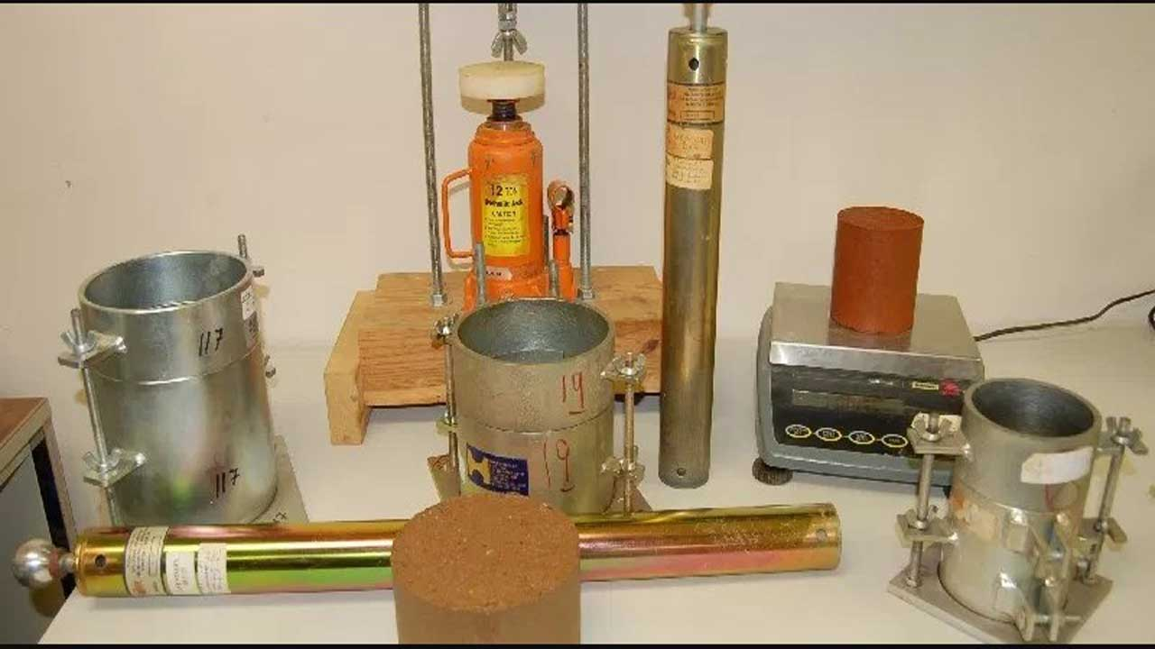
SOIL TESTING: PROCTOR COMPACTION
Optimum Moisture Content to Achieve Maximum Dry Density
- Moisture is required to lubricate the soil particles
- Too much moisture will make the soil uncompressible; the more moisture added, the weaker the soil matrix once dried
- Full surface saturation of particles with no excess moisture
Modified Proctor compaction curve used to determine an optimum gravimetric moisture content of 6.71%.
Proctor compaction equipment, including molds, hammers, and scale
Notes:
Okay, next, we need to determine how much water, or moisture, to add to the soil.
If we try to compress dry soils together, we will find it difficult for the soil particles to slip past each other, especially if they are angular (which is also best if we want the particles to stay put once they have been densified).
So, we need to lubricate them.
However, too much lubrication can be a bad thing because water occupies space, and once the water dries, it will leave voids behind. Therefore, our goal is to add just enough moisture to lubricate all of the grains of soil, but without adding any excess moisture that will contribute to increased voids.
This we call surface saturation, or Optimum Moisture Content.
If we can determine the optimum moisture content, we can get closer to achieving maximum dry density, which will typically result in a stronger material.

Slide 29
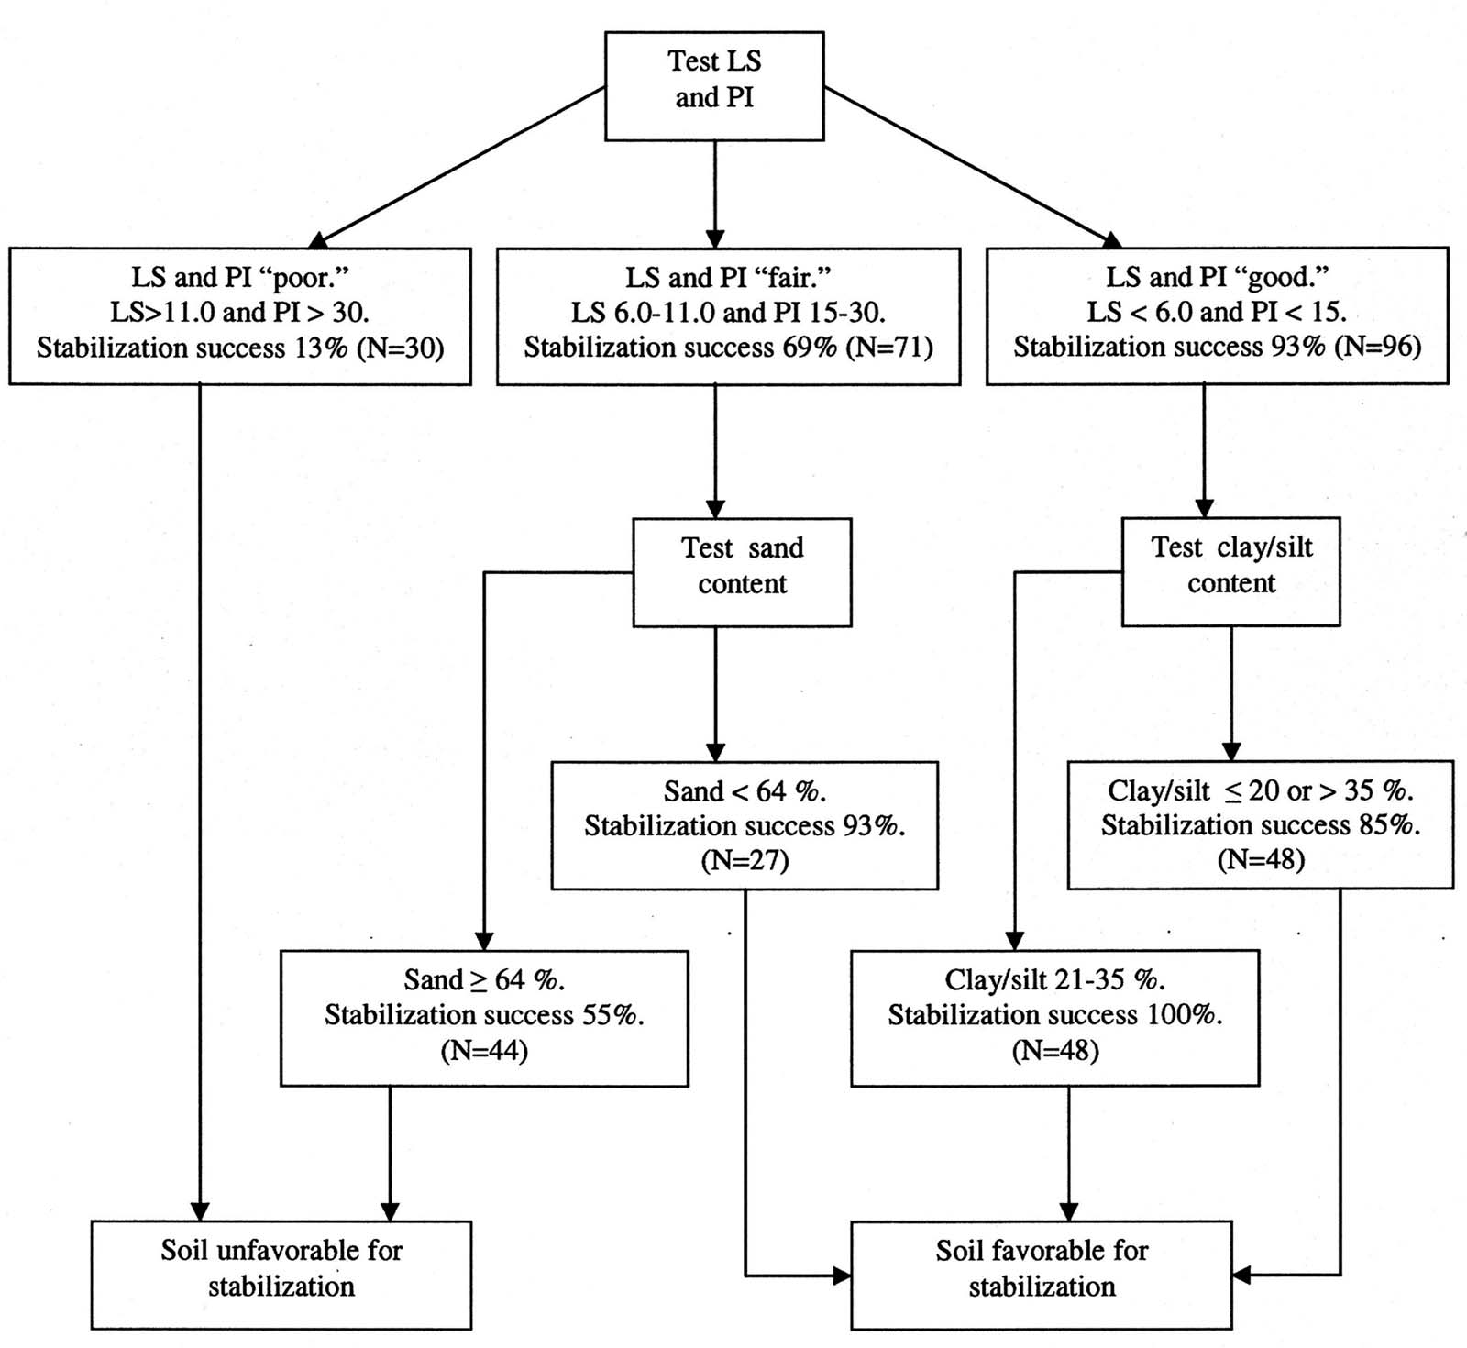
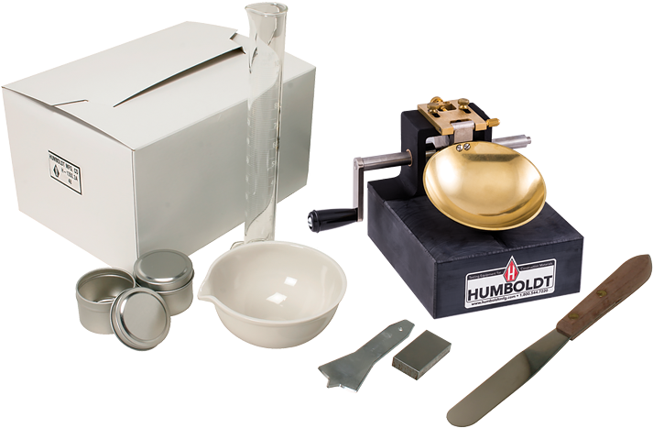
SOIL TESTING: ATTERBERG LIMITS
Determining the Shrinkage Limit, the Plastic Limit, Liquid Limit, Linear Shrinkage, and Plasticity Index
- Determines the plasticity of the soil: “the ability of a material to undergo permanent deformation under stress without cracking”.
- Research has shown that the Plasticity Index of the soil may be the single greatest determinant of soil suitability
“Recommended practical stepwise procedure for determining soil favorability for stabilization based on testing natural soil properties. Stabilization success is the percentage of samples with UCS 2 MPa, as tested in the study.” From Burroughs, Steve, “Soil Property Criteria for Rammed Earth Stabilization,” Journal of Materials in Civil Engineering, 2008, 20(3): 264-273.
Typical tools and equipment for conducting the Atterberg Limits Tests.
Notes:
Now we know what the soil is comprised of, and we know how much moisture to add to it to achieve maximum dry density.
Next, it is useful to know how plastic the soil is; by this I mean, the soil’s ability to undergo permanent deformation under stress without cracking.
A series of tests, called the Atterberg Limits, have been developed to determine a soils’ shrinkage, plastic, and liquid limits, and from here we can determine its Linear Shrinkage and its Plasticity Index.
Studies, such as the one where this flow chart comes from, have shown that these two characteristics, Linear Shrinkage and Plasticity Index, are perhaps the most accurate indicators of whether a soil will be suitable for at least certain types of earth building techniques. It is not always necessary to conduct all of these tests, but the more we know about a soil, the more confident we can be in its suitability for a given task.

Slide 30
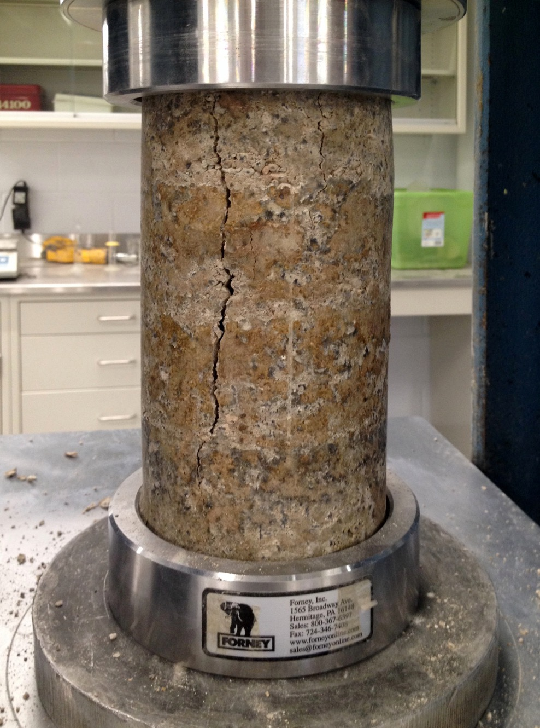
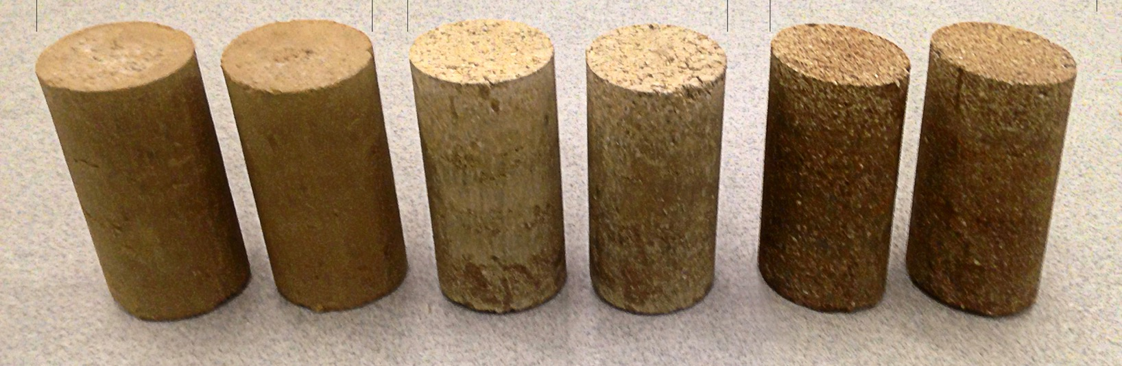
SOIL TESTING: UNCONFINED COMPRESSIVE STRENGTH
Ultimately, the unconfined compressive strength of the soil is sought
- Compressive Strength: “mechanical test measuring the maximum amount of compressive load a material can bear before fracturing.”
Notes:
Ultimately, one of the most important criteria for earth as a building material is its compressive strength.
The compressive strength is the maximum amount of compressive load a material can bear before fracturing; while tensile strength, on the other hand, can be visualized as the capacity of a material to resist being pulled apart. Most dense materials such as stone, brick, concrete, and earth have relatively high compressive strengths and relatively low tensile strengths. The low tensile strengths are typically addressed, if needed, with the addition of tensile reinforcement, such as steel bars in concrete, of natural fibers in mud brick. Here you can see a few rammed earth cylinders I prepared and crushed using a compressive strength load frame.

Slide 31
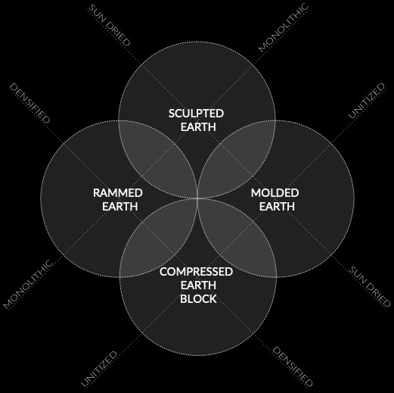
TECHNIQUES OF EARTH ARCHITECTURE
Notes:
Now that we have examined the classification of soils are their particles, and the various ways to test soils for suitability as a building material, now I would like to briefly discuss the variety of techniques of earth architecture. Long before humans learned to sinter pulverized limestone into cement for use in concrete, we harnessed the binding power of clay to form earth into adobe bricks, cobb walls, and rammed earth. In fact, there are many earth building techniques; however, most of these can be classified into one of four categories: molded earth, sculpted earth, rammed earth, and compressed earth block. As you can see from this diagram, these techniques differ based on the primary method for acquiring strength (that is, through modest densification and drying or through more aggressive densification techniques) and also in the form they take, whether they are unitized or made monolithically. Let’s examine each one of these categories in a little more detail, and take a look at some examples.

Slide 32
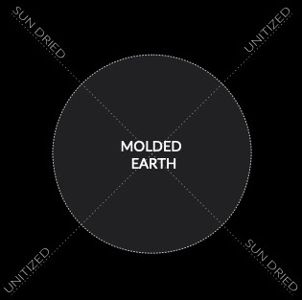
MOLDED EARTH: MUD BRICK / ADOBE
Notes:
Let’s start with Molded Earth, a term I am using to include mud bricks of all kinds, including the one you are probably most familiar with, Adobe.
These are characterized by being unitized, that is, made into standard modules to units, and sun dried.

Slide 33
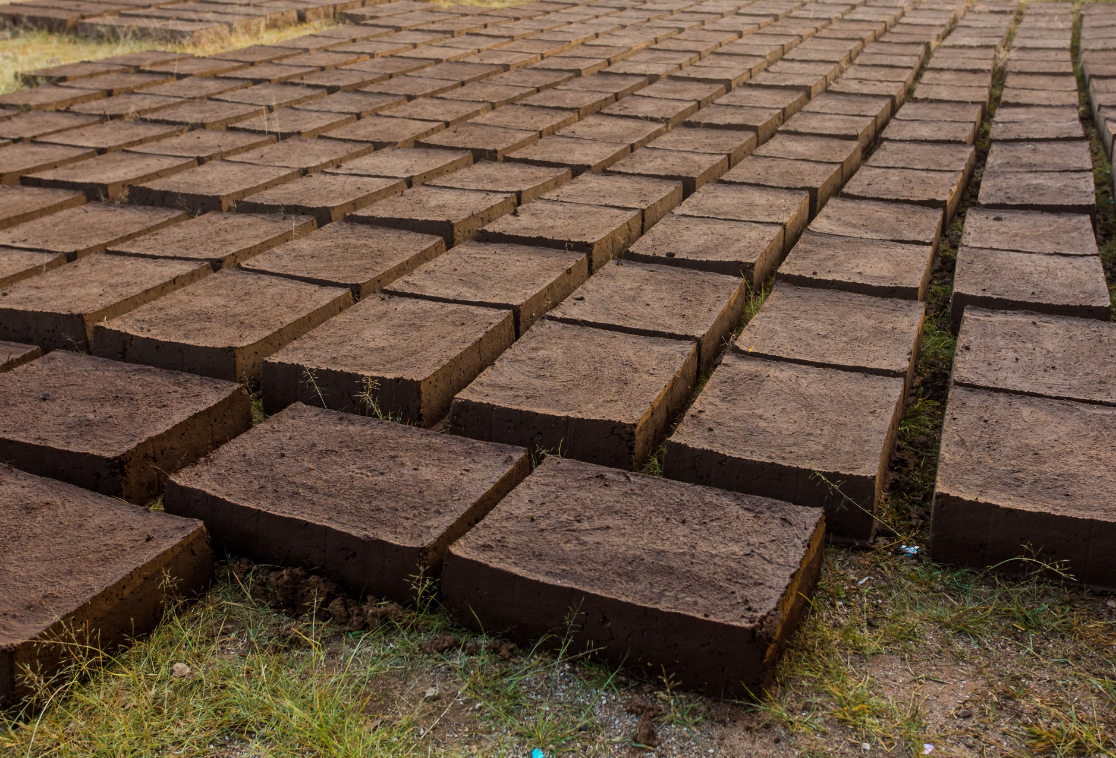
MOLDED EARTH: MUD BRICK / ADOBE
Gains strength from drying in the sun (low embodied energy)
Minimal forms required, ease of fabrication
Unitized and modular, ease of construction
Not as strong as other forms of earthen building; can be labor-intensive
Drying adobe bricks. (Photo credit: PhotoSpirit)
Notes:
Mud bricks are generally formed using a clayey soil kneaded together with a fibrous material such as straw, often using reusable molds to form standard-sized bricks.
These bricks are allowed to bake in the heat of the sun, which causes the water to evaporate out and allows the clay to bind the soil particles together. Consequently, mud bricks have very low embodied energy (that is, the amount of energy required to extract, fabricate, and implement a specific material). Low embodied energy is very good if we wish to be good stewards of the earth and if we wish to slow, halt, or even reverse climate change.
Due to the minimal amount of formwork required, mud bricks are relatively simple to make,
and because they are modular, they can also be relatively easy to use to construct building elements such as walls, vaults, or domes. However, due to their unitized nature, they do require craftspeople skilled in masonry techniques.
Also, due to their strength coming from modest kneading/compaction and sun drying, mud bricks are often not as strong as rammed or compressed earth building techniques.

Slide 34
TECHNIQUES OF EARTH ARCHITECTURE
Notes:
Returning to the four techniques of earth architecture…

Slide 35
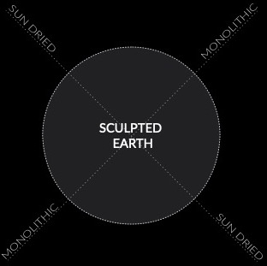
SCULPTED EARTH: COB / CHINEH / PAKHSA
Notes:
…next, we examine Sculpted Earth,
that is, earth that gains its strength by drying in the sun, but unlike mud brick, is formed monolithically rather than in small standard-sized units.

Slide 36
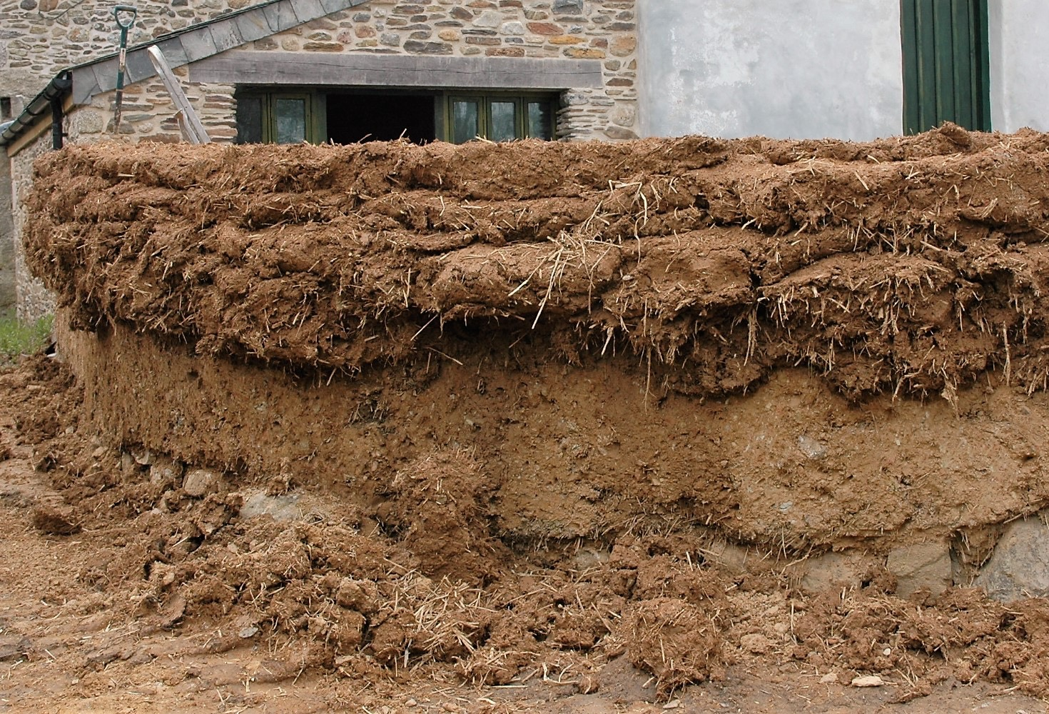
SCULPTED EARTH: COB / CHINEH / PAKHSA
Gains strength from drying in the sun and manual kneading (very low embodied energy)
No/minimal forms required, ease of fabrication
Monolithic and do-it-yourself-friendly, ease of construction
Not as strong as other earthen building techniques; can be slow and imprecise
Cob wall construction. (Credit: Leslie Cornell Building Restoration)
Notes:
Sculpted earth includes techniques such as cob or chineh, each differing slightly in mixture and technique. Here you can see a cob wall under construction. Each cob, or loaf, of earth is mixed with straw or similar fiber, and using a cob fork, the earth is thrown onto the emerging wall, where it is kneaded into the adjacent soil, often by someone walking, barefoot, across the top of the wall, back and forth. Once the wall reaches its desired height, its surface would be cut smooth using a large knife, and once dried, it would be plastered, similar to mud brick.
This technique is even lower in embodied energy than mud brick,
typically, due to its nearly complete lack of formwork.
It is also an extremely forgiving and generous construction technique, that often invites the community to participate.
Similar to mud brick, it is not as strong as compacted earthen materials, and it can be a slow and imprecise technique. However, its casual and approachable quality can be very appealing.

Slide 37
TECHNIQUES OF EARTH ARCHITECTURE
Notes:
…

Slide 38
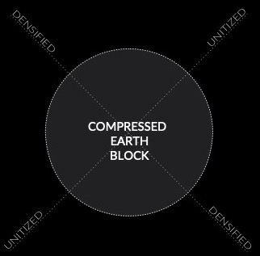
COMPRESSED EARTH BLOCK
Notes:
And finally, we come to compressed earth block,
the newest form of earth building.

Slide 39
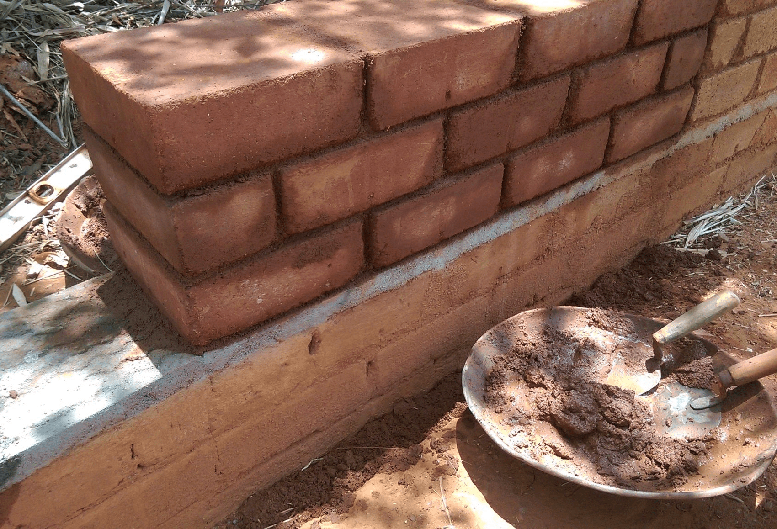
COMPRESSED EARTH BLOCK
Gains strength from compression; is stronger than other forms of unitized earth construction
No/minimal forms required; uses conventional masonry techniques
Unitized construction allows to off-site fabrication
Typically stabilized with cement or other industrial admixtures, which strengthen, but also increase embodied energy
Compressed earth block wall. (Credit: UN Habitat)
Notes:
Compressed earth blocks, or CEBs,
gain their strength through compaction using a specially designed machine which presses the soil into a defined shape. This technique tends to be much stronger than sundried techniques.
And since it is unitized, minimal to no formwork is required. Instead, more conventional masonry techniques are required.
Its modular nature allows CEBs to be produced off-site, which can result in increased quality control and a reduction in the impacts of inclement weather on construction schedules.
CEBs are typically stabilized with industrial admixtures for added strength and durability, but this has the adverse side-effect of increasing embodied energy as well. Still, CEBs represent a much more sustainable alternative to most other masonry units.

Slide 41
TECHNIQUES OF EARTH ARCHITECTURE
Notes:
…

Slide 42
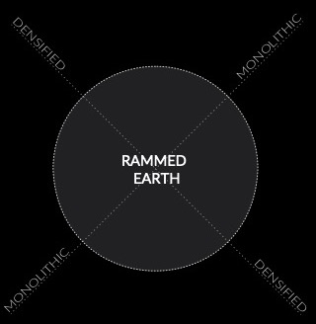
RAMMED EARTH
Notes:
Next, we explore my preferred method, Rammed Earth,
which gains its strength through compaction and vibration, and used to create monolithic building elements.

Slide 43
RAMMED EARTH
Gains strength from vibration and compaction
Strongest form of earthen building; can be very durable
Monolithic wall construction; layering can contribute to aesthetics
Requires sturdy formwork; can be labor intensive; may require expensive equipment
Dirt Works Studio ramming a wall. (Video credit: Dirt Works Studio)
Notes:
<video plays>
Due to significantly increased compaction forces, rammed earth can be substantially stronger than molded and sculpted forms of earth building.
Its strength and durability can begin to rival more conventional industrial materials and assemblies.
The layering of rammed earth, if exposed, can contribute to its aesthetic appeal.
However, rammed earth requires robust formwork, which adds cost and embodied energy, may require more expensive equipment to reduce labor, but inevitably remains labor intensive. Rammed earth can be unstabilized, meaning used without any admixtures to increase strength, or it can be stabilized, usually with a small amount of Portland cement or lime. I will come back to stabilization a bit later.

Slide 44
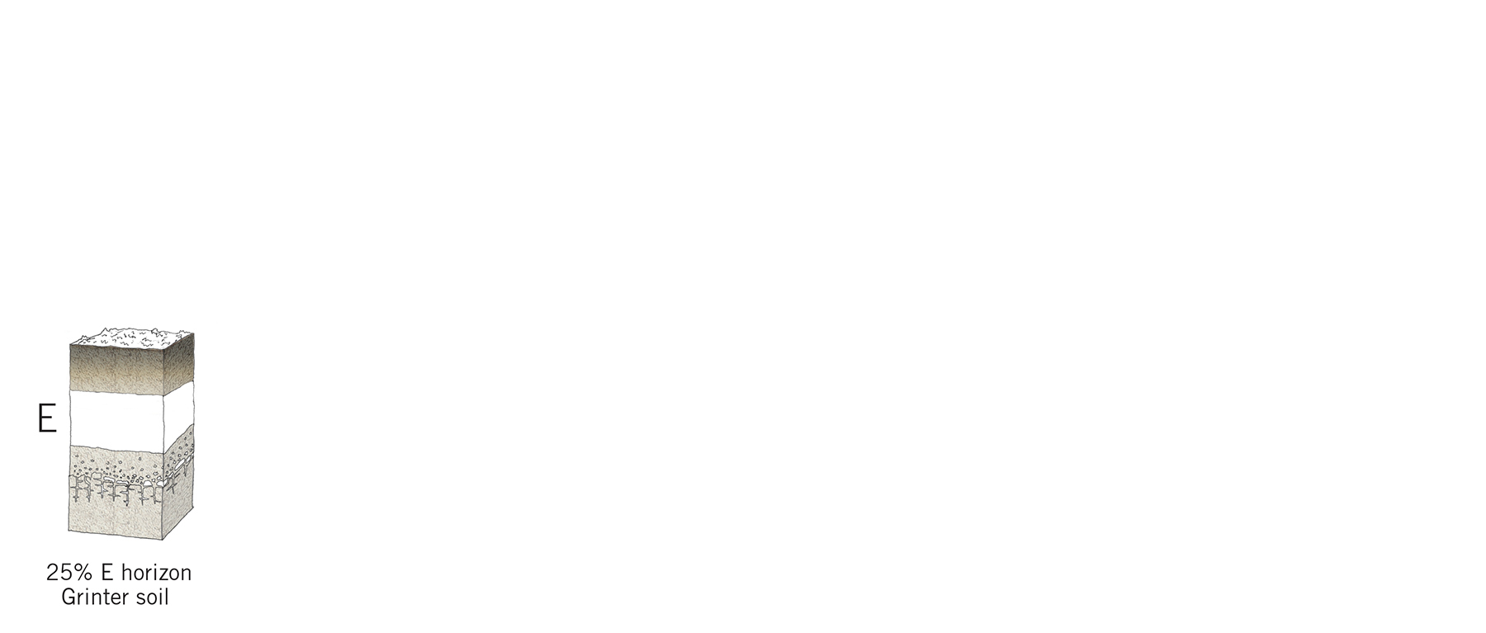
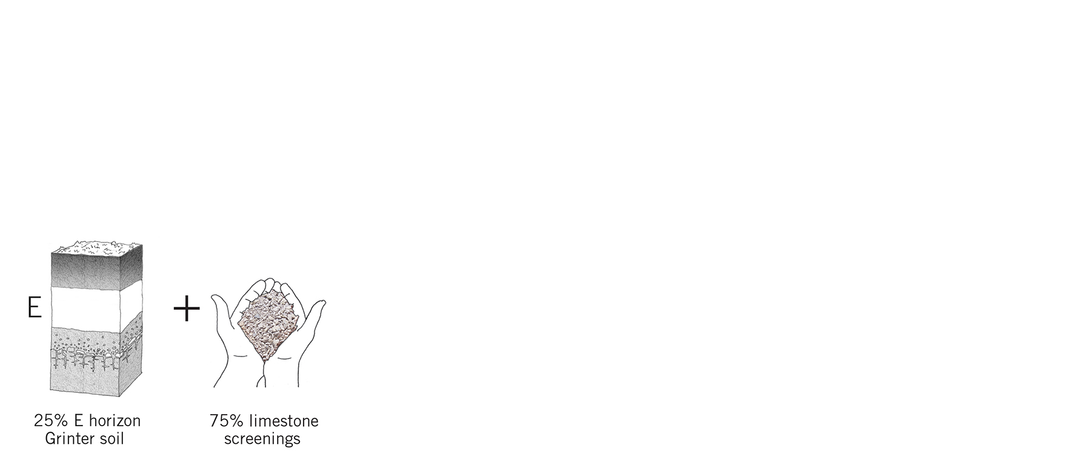
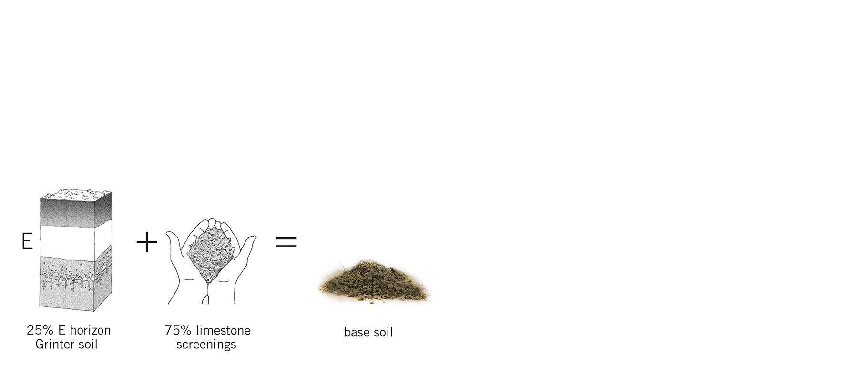
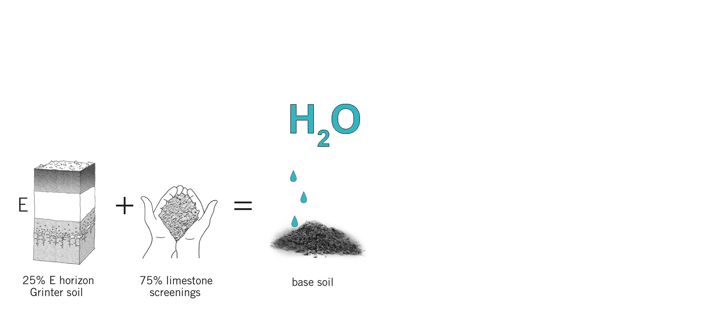
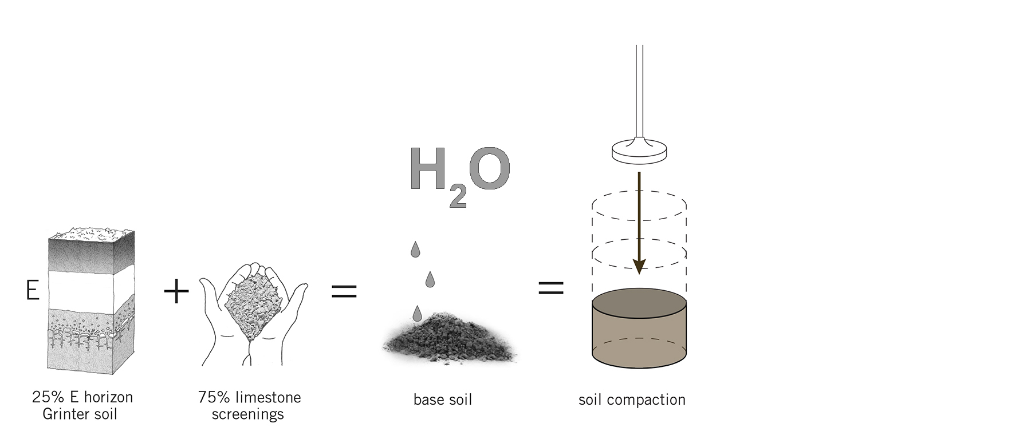
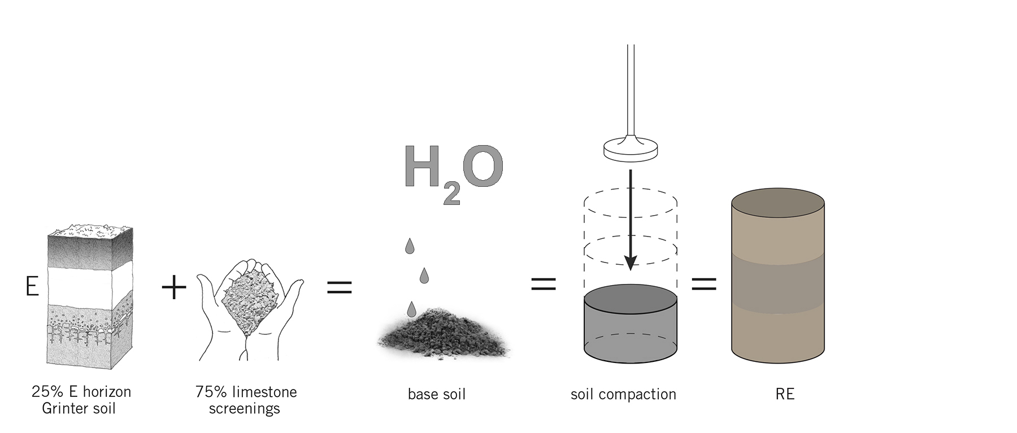
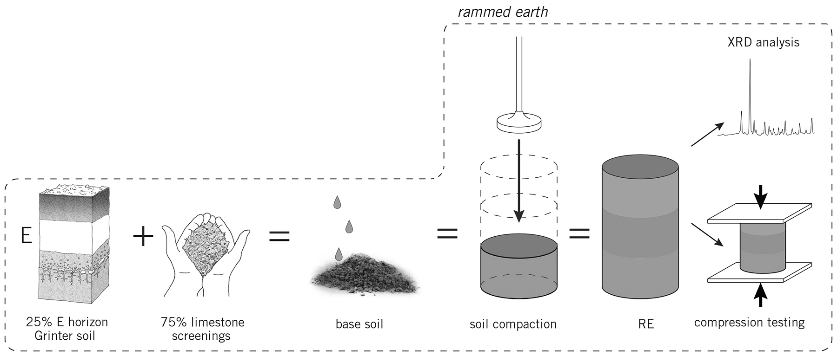
RAMMED EARTH PROCESS
Notes:
I will start just by mentioned one example of my material research before diving into a few of the designbuild projects.
A more substantial line of inquiry into biostabilization for me involves the use of microorganisms to strengthen the material. For this, I collaborated with researchers in soil science and geomicrobiology.
The basic idea was to take the standard process of making and testing rammed earth,
in a nutshell: 1) sourcing soils,
2) adding water,
3) compacting the soil,
and 4) testing its performance;
and marrying this with a process called microbially induced calcite precipitation, which in the lab, involves: 1) taking a microorganism, such as Sporosarcina pastuerii,
2) adding a source of calcium,
3) adding a source of urea, and
4) adding this to soil. Basically, the urea causes the microorganisms to become hyperactive as they feed on it, which raises the pH levels in the soil and causes a chemical reaction with the calcium, which results in the formation of calcium carbonate, and eventually bonds the grains of soil together, forming a limestone-like matrix.

Slide 45


Slide 46
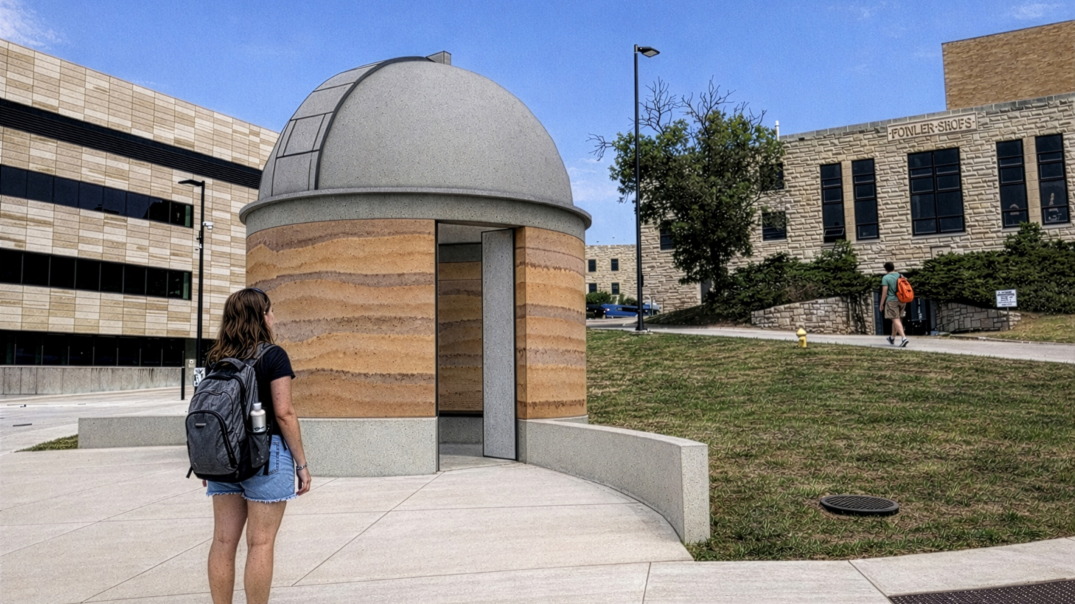
TOMBAUGH OBSERVATORY [2026]

Slide 47

TOMBAUGH OBSERVATORY [2026]

Slide 48
THANK YOU

